Slide 1
Convex Optimization
Rupaj Kumar Nayak
IIIT Bhubaneswar

Slide 2
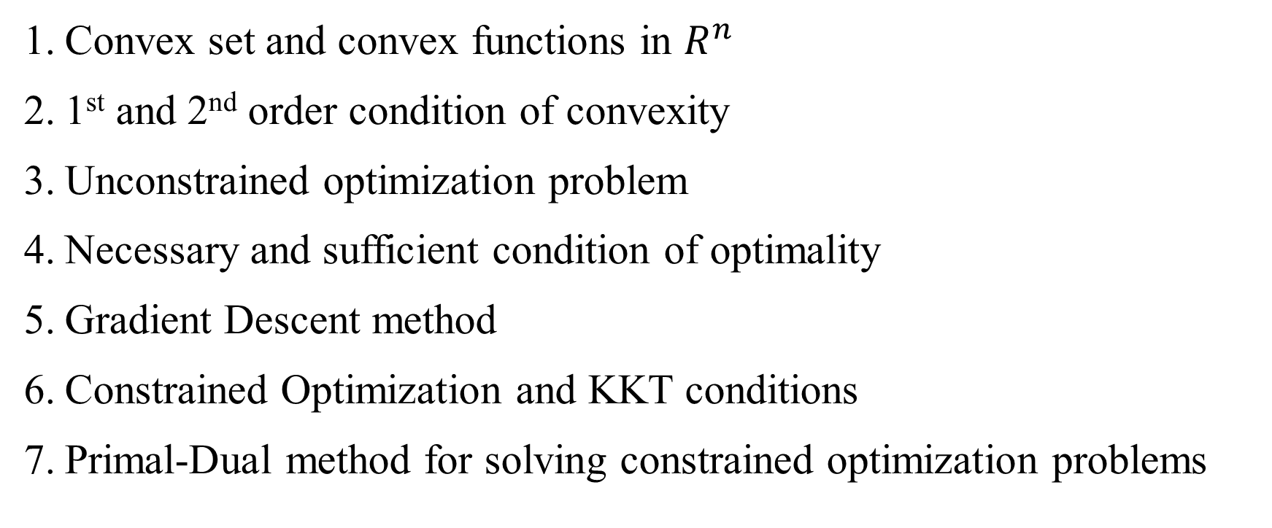
Topics to be covered
Convex set and convex functions in $R^{n}$
1st and 2nd order condition of convexity
Unconstrained optimization problem
Necessary and sufficient condition of optimality
Gradient Descent method
Constrained Optimization and KKT conditions
Primal-Dual method for solving constrained optimization problems

Slide 3
Why Convex Optimization required to understand?

Slide 4
What is Convex Optimization?
A branch of optimization that works on minimizing a convex objective function subject to convex constraints.
Optimization issues are studied in this context when the objective function and feasible set are both convex.

Slide 5
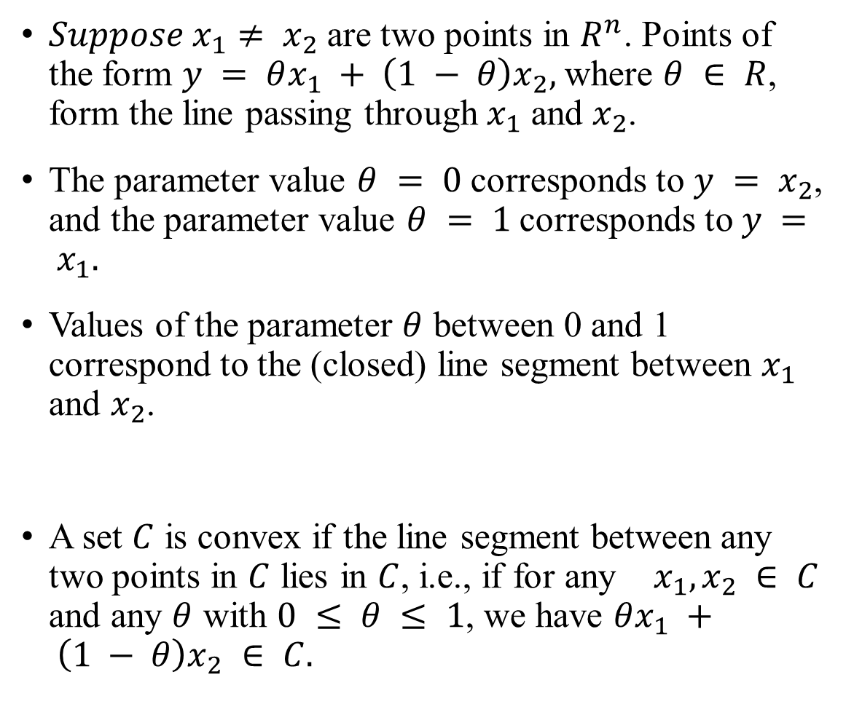

Convex set and convex functions in $R^{n}$
$Suppose x_{1}≠ x_{2}$are two points in $R^{n}$. Points of the form $y = θx_{1} + \left(1 − θ\right)x_{2},$where $θ ∈ R$, form the line passing through $x_{1}$ and $x_{2}$.
The parameter value $θ = 0$ corresponds to $y = x_{2}$, and the parameter value $θ = 1$corresponds to $y = x_{1}.$
Values of the parameter $θ$ between 0 and 1 correspond to the (closed) line segment between $x_{1}$ and $x_{2}$.
A set $C$ is convex if the line segment between any two points in $C$ lies in $C$, i.e., if for any $x_{1}, x_{2} ∈ C$ and any $θ$ with $0 ≤ θ ≤ 1$, we have $θx_{1} + \left(1 − θ\right)x_{2} ∈ C.$

Slide 6
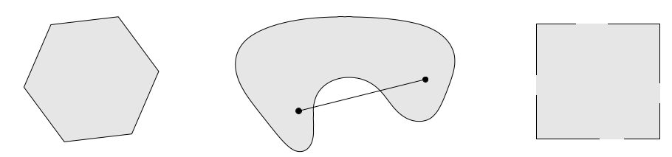
Convex set
Left. The hexagon, which includes its boundary (shown darker), is convex. Middle. The kidney shaped set is not convex, since the line segment between the two points in the set shown as dots is not contained in the set. Right. The square contains some boundary points but not others and is not convex.

Slide 7
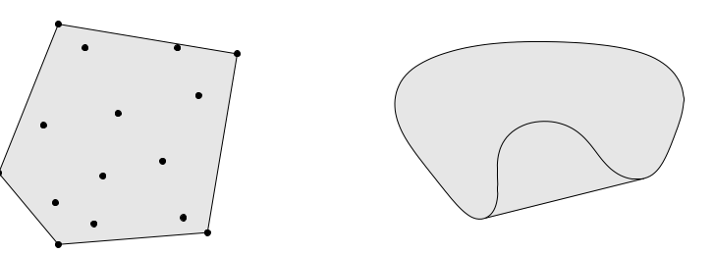

The convex hulls of two sets in $R^{2}$.
Left. The convex hull of a set of ﬁfteen points (shown as dots) is the pentagon (shown shaded). Right. The convex hull of the kidney shaped set is the shaded set.
Roughly speaking, a set is convex if every point in the set can be seen by every other point, along an unobstructed straight path between them, where unobstructed means lying in the set. Every aﬃne set is also convex, since it contains the entire line between any two distinct points in it, and therefore also the line segment between the points.

Slide 8
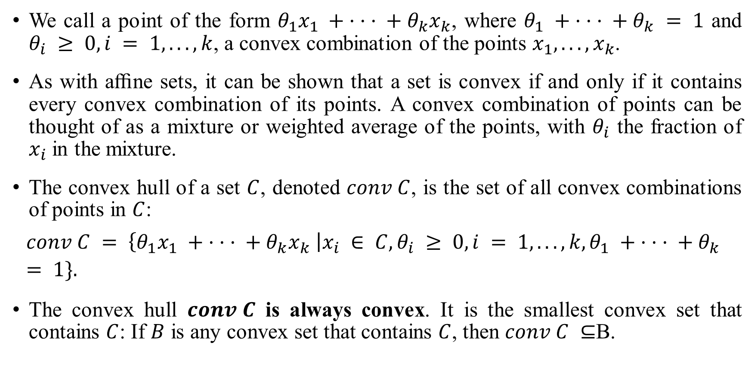
Convex Hull
We call a point of the form $θ_{1}x_{1} + · · · + θ_{k}x_{k}$, where $θ_{1} + · · · + θ_{k} = 1$ and $θ_{i} ≥ 0, i = 1, . . . , k$, a convex combination of the points $x_{1}, . . . , x_{k}$.
As with aﬃne sets, it can be shown that a set is convex if and only if it contains every convex combination of its points. A convex combination of points can be thought of as a mixture or weighted average of the points, with $θ_{i}$ the fraction of $x_{i}$ in the mixture.
The convex hull of a set $C$, denoted $conv C$, is the set of all convex combinations of points in $C$:
$$conv C = \left\{θ_{1}x_{1} + · · · + θ_{k}x_{k} \right|x_{i} ∈ C, θ_{i} ≥ 0, i = 1, . . . , k, θ_{1} + · · · + θ_{k} = 1\}.$$
The convex hull $conv C$ is always convex. It is the smallest convex set that contains $C$: If $B$ is any convex set that contains $C$, then $conv C ⊆$B.

Slide 9
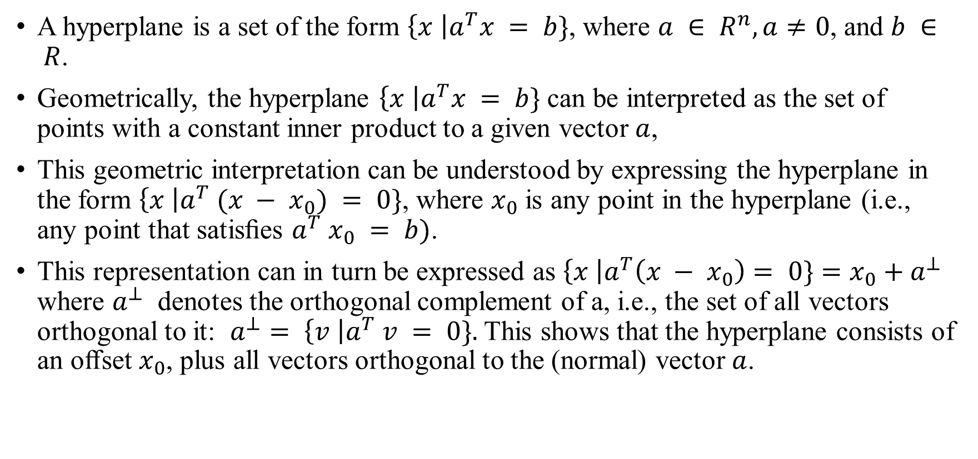
Hyperplanes and half spaces
A hyperplane is a set of the form $\left\{x \right|a^{T}x = b\}$, where $a ∈ R^{n}, a≠0$, and $b ∈ R$.
Geometrically, the hyperplane $\left\{x \right|a^{T}x = b\}$ can be interpreted as the set of points with a constant inner product to a given vector $a$,
This geometric interpretation can be understood by expressing the hyperplane in the form $\left\{x \right|a^{T} (x − x_{0}) = 0\}$, where $x_{0}$ is any point in the hyperplane (i.e., any point that satisﬁes $a^{T} x_{0} = b)$.
This representation can in turn be expressed as $\left\{x \right|a^{T}\left(x − x_{0}\right)= 0\}=x_{0}+a^{⊥}$ where $a^{⊥}$ denotes the orthogonal complement of a, i.e., the set of all vectors orthogonal to it: $a^{⊥}= \left\{v \right|a^{T} v = 0\}.$ This shows that the hyperplane consists of an oﬀset $x_{0}$, plus all vectors orthogonal to the (normal) vector $a$.

Slide 10
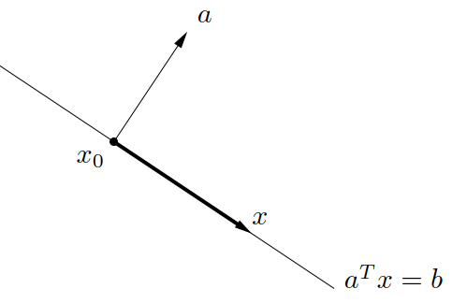

Hyperplane in $R^{2}$, with normal vector $a$ and a point $x_{0}$ in the hyperplane

Slide 11
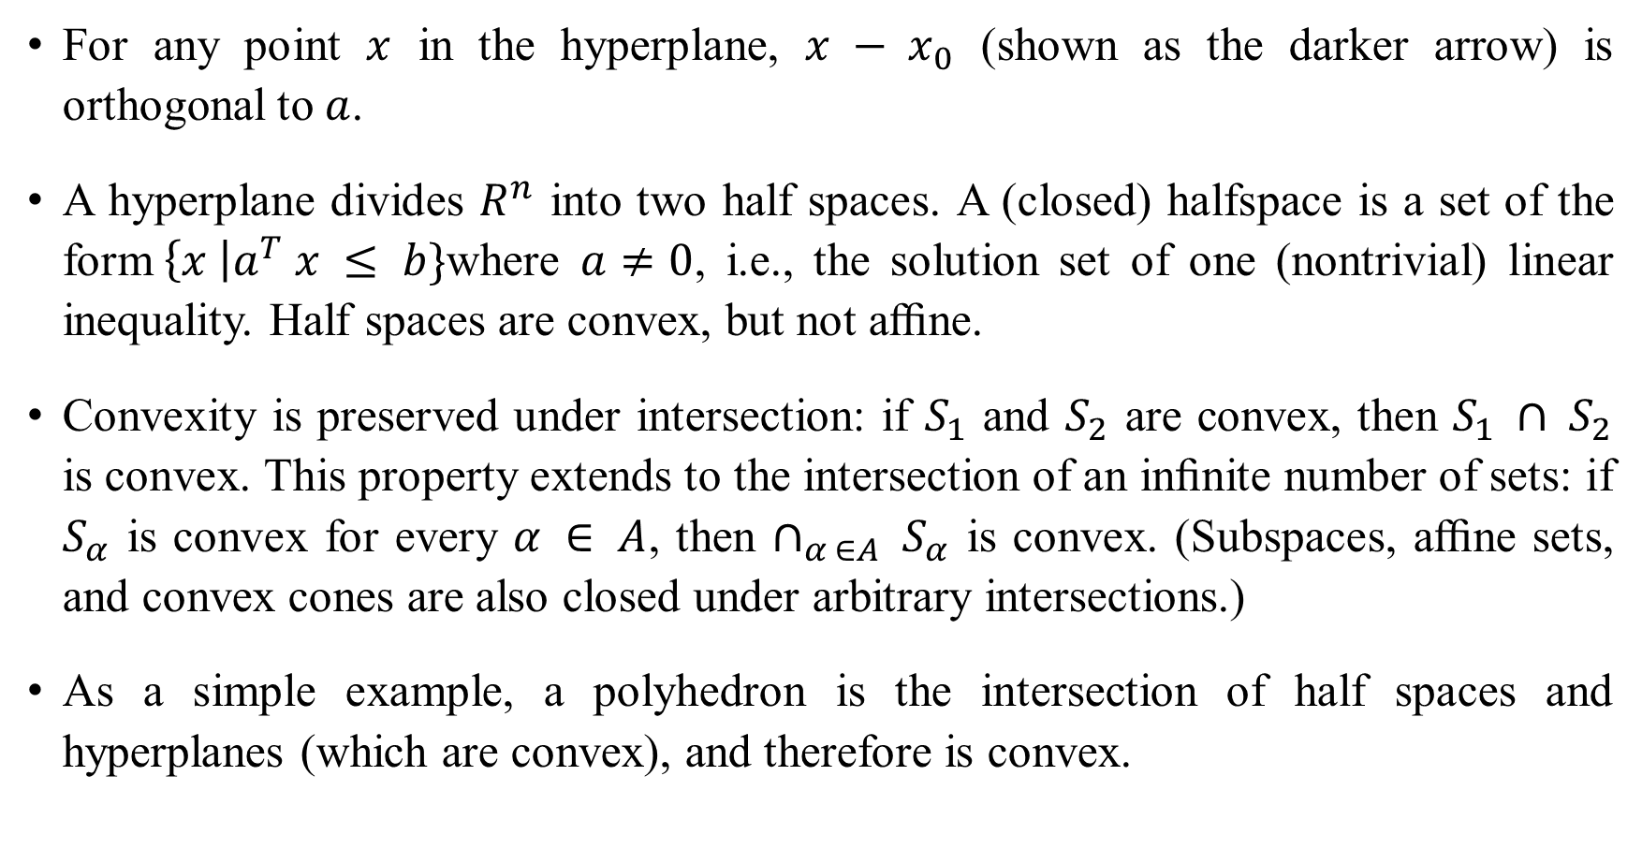
For any point $x$ in the hyperplane, $x − x_{0}$ (shown as the darker arrow) is orthogonal to $a$.
A hyperplane divides $R^{n}$ into two half spaces. A (closed) halfspace is a set of the form$\left\{x \right|a^{T} x ≤ b\}$where $a≠0$, i.e., the solution set of one (nontrivial) linear inequality. Half spaces are convex, but not aﬃne.
Convexity is preserved under intersection: if $S_{1}$ and $S_{2}$ are convex, then $S_{1} ∩ S_{2}$ is convex. This property extends to the intersection of an inﬁnite number of sets: if $S_{α}$ is convex for every $α ∈ A$, then $∩_{α ∈A} S_{α}$ is convex. (Subspaces, aﬃne sets, and convex cones are also closed under arbitrary intersections.)
As a simple example, a polyhedron is the intersection of half spaces and hyperplanes (which are convex), and therefore is convex.

Slide 12
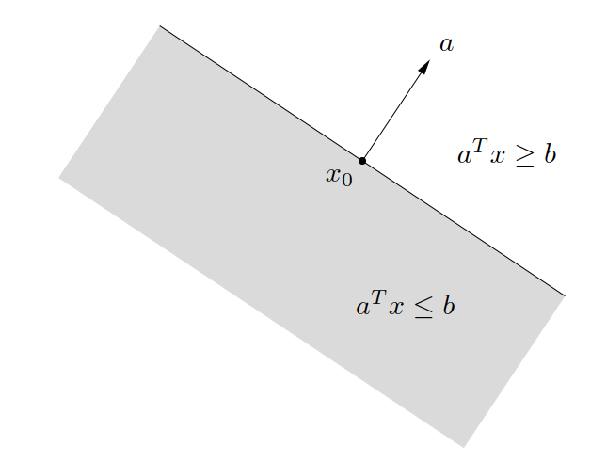
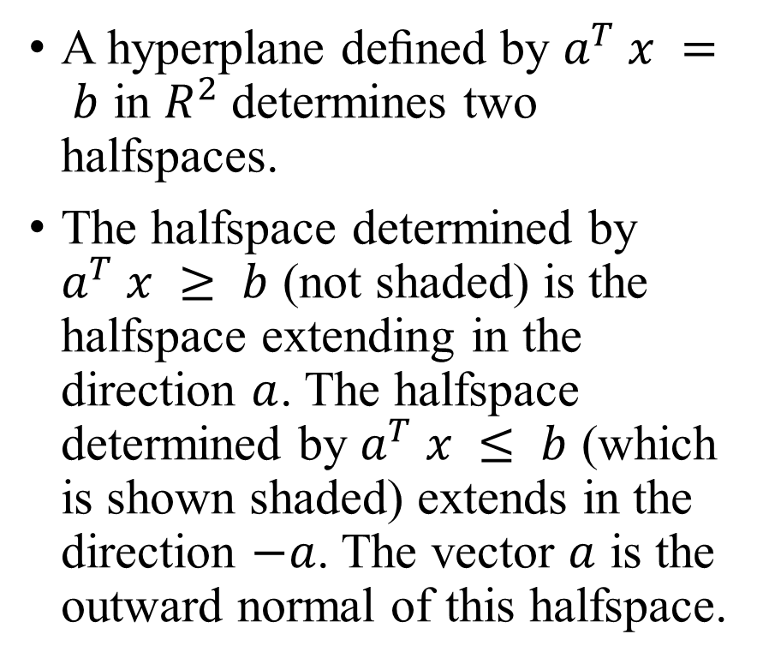
Halfspaces
A hyperplane deﬁned by $a^{T} x = b$ in $R^{2}$determines two halfspaces.
The halfspace determined by $a^{T} x ≥ b$ (not shaded) is the halfspace extending in the direction $a$. The halfspace determined by $a^{T} x ≤ b$ (which is shown shaded) extends in the direction $−a$. The vector $a$ is the outward normal of this halfspace.

Slide 13
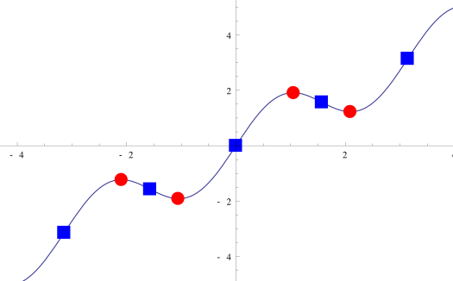
Stationary point
A stationary point of a function is a point where the derivative of a function is equal to zero and can be a minimum, maximum, or a point of inflection. At a stationary point the slope of the graph of the function is zero (a straight line). They are called stationary points because they are points where the function is neither increasing nor decreasing.

Slide 14
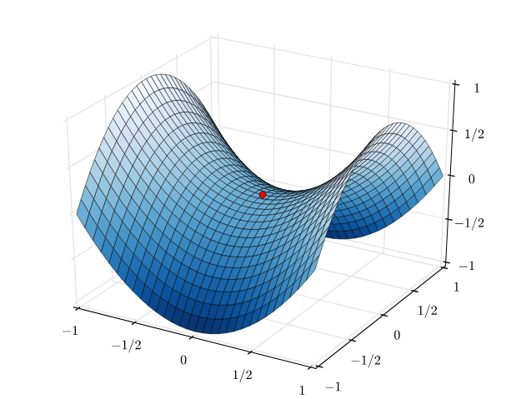
Saddle point

Slide 15
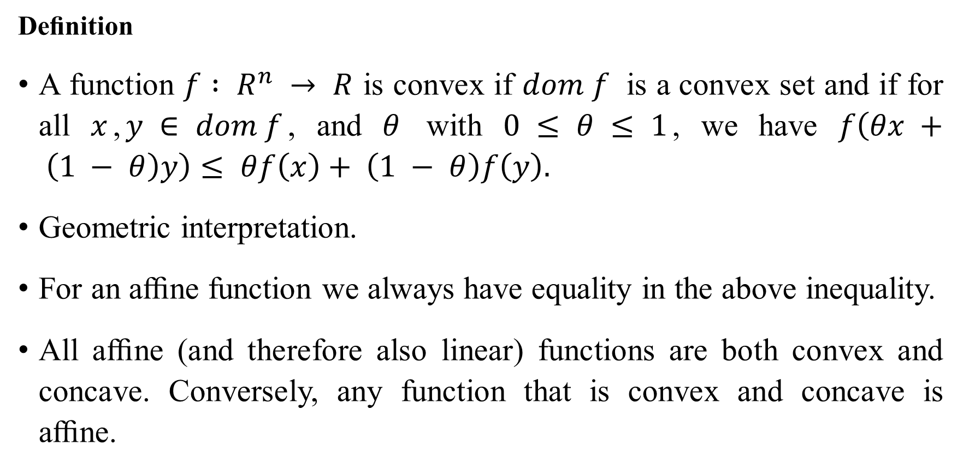
Convex functions
Deﬁnition
A function $f : R^{n} → R$ is convex if $dom f$ is a convex set and if for all $x$,$y ∈ dom f$, and $θ$ with $0 ≤ θ ≤ 1$, we have $f\left(θx + \left(1 − θ\right)y\right)≤ θf\left(x\right)+ \left(1 − θ\right)f\left(y\right).$
Geometric interpretation.
For an aﬃne function we always have equality in the above inequality.
All aﬃne (and therefore also linear) functions are both convex and concave. Conversely, any function that is convex and concave is aﬃne.

Slide 16
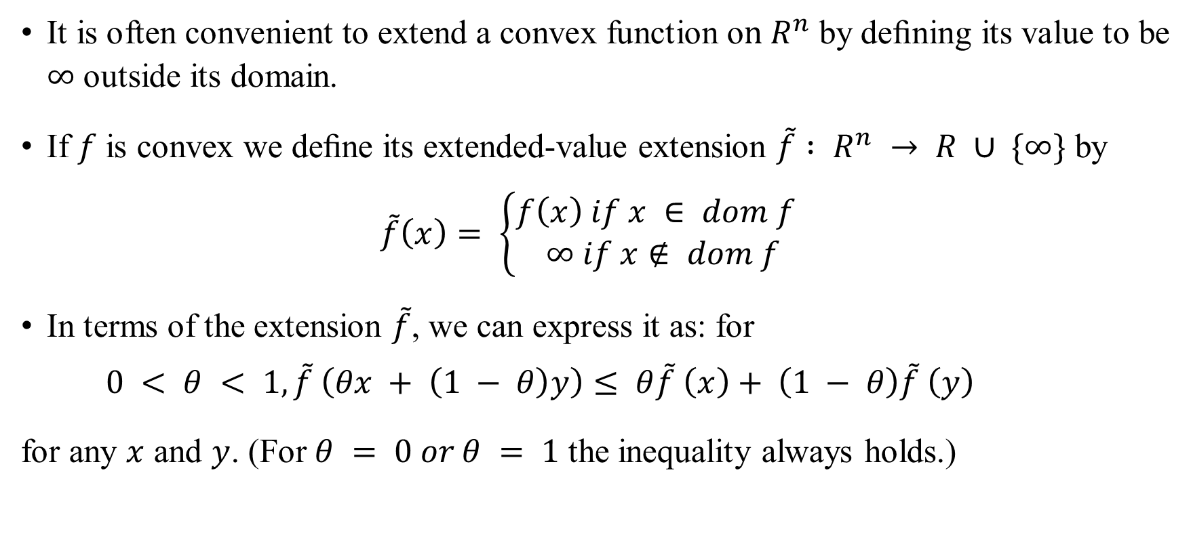
Extended-value extensions
It is often convenient to extend a convex function o$n R^{n}$ by deﬁning its value to be $∞$ outside its domain.
If $f$ is convex we deﬁne its extended-value extension $\tilde{f} : R^{n} → R ∪ \{∞\}$ by
$$\tilde{f}\left(x\right)= \left\{\begin{aligned}f\left(x\right) if x ∈ dom f \\ ∞ if x∉ dom f\end{aligned}\right.$$
In terms of the extension $\tilde{f}$, we can express it as: for
$$0 < θ < 1, \tilde{f} \left(θx + \left(1 − θ\right)y\right)≤ θ\tilde{f} \left(x\right)+ \left(1 − θ\right)\tilde{f} \left(y\right)$$
for any $x$ and $y$. (For $θ = 0 or θ = 1$ the inequality always holds.)

Slide 17
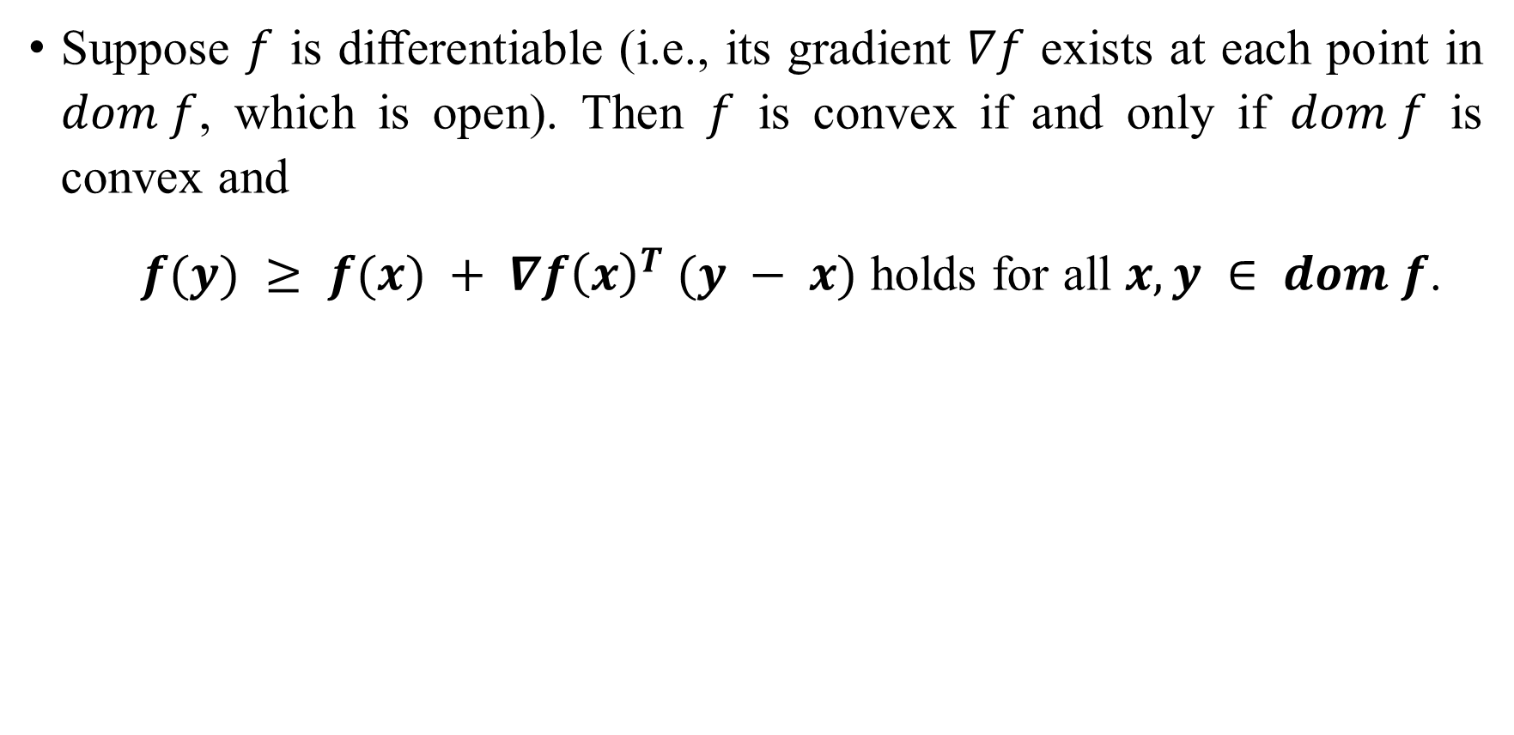
First-order conditions
Suppose $f$ is diﬀerentiable (i.e., its gradient $∇f$ exists at each point in $dom f$, which is open). Then $f$ is convex if and only if $dom f$ is convex and
$f(y) ≥ f(x) + ∇f{\left(x\right)}^{T} (y − x)$ holds for all $x, y ∈ dom f$.

Slide 18
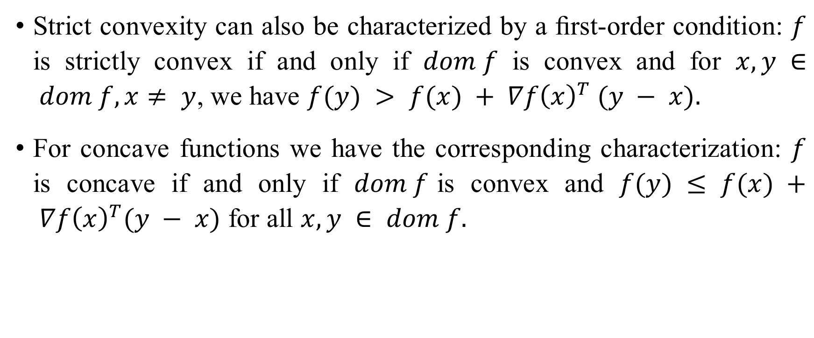
Cont……
Strict convexity can also be characterized by a ﬁrst-order condition: $f$ is strictly convex if and only if $dom f$ is convex and for $x, y ∈ dom f, x≠ y$, we have $f(y) > f(x) + ∇f{\left(x\right)}^{T} (y − x).$
For concave functions we have the corresponding characterization: $f$ is concave if and only if $dom f$is convex and $f(y) ≤ f(x) + ∇f{\left(x\right)}^{T}(y − x)$ for all $x, y ∈ dom f.$

Slide 19
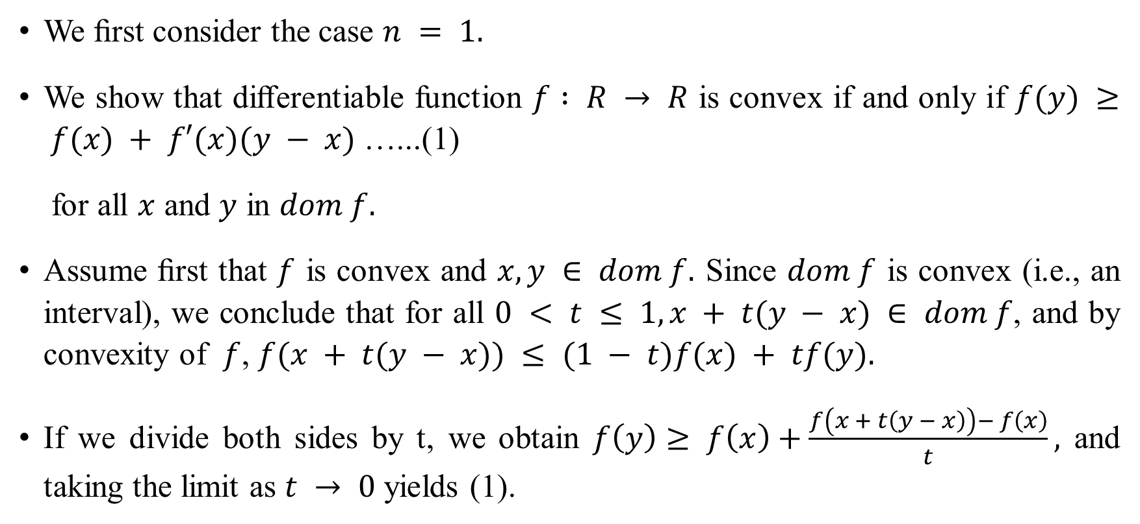
Proof of ﬁrst-order convexity condition
We ﬁrst consider the case $n = 1.$
We show that diﬀerentiable function $f : R → R$ is convex if and only if $f(y) ≥ f(x) + f′(x)(y − x)$ …...(1)
for all $x$ and $y$ in $dom f.$
Assume ﬁrst that $f$ is convex and $x, y ∈ dom f.$ Since $dom f$ is convex (i.e., an interval), we conclude that for all $0 < t ≤ 1, x + t(y − x) ∈ dom f$, and by convexity of $f$, $f(x + t(y − x)) ≤ (1 − t)f(x) + tf(y).$
If we divide both sides by t, we obtain $f\left(y\right)≥ f\left(x\right)+\frac{f\left(x + t\left(y − x\right)\right)− f\left(x\right)}{t},$ and taking the limit as $t → 0$ yields (1).

Slide 20
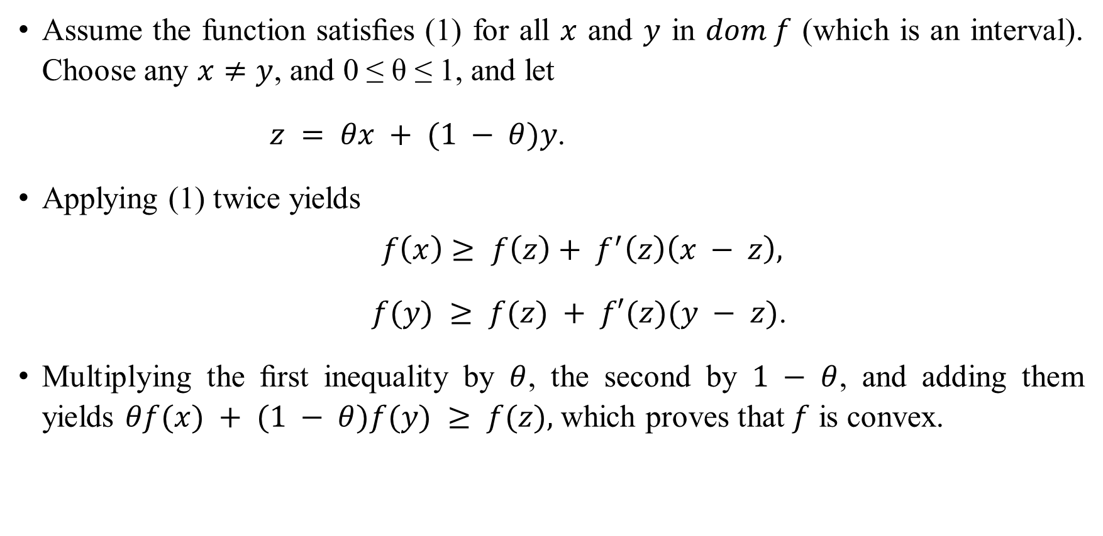
Suﬃciency
Assume the function satisﬁes (1) for all $x$ and $y$ in $dom f$ (which is an interval). Choose any $x≠y$, and 0 ≤ θ ≤ 1, and let
$z = θx + (1 − θ)y$.
Applying (1) twice yields
$$f\left(x\right)≥ f\left(z\right)+ f^{′}\left(z\right)\left(x − z\right),$$
$f(y) ≥ f(z) + f′(z)(y − z)$.
Multiplying the ﬁrst inequality by $θ$, the second by $1 − θ$, and adding them yields $θf(x) + (1 − θ)f(y) ≥ f(z),$ which proves that $f$ is convex.

Slide 21
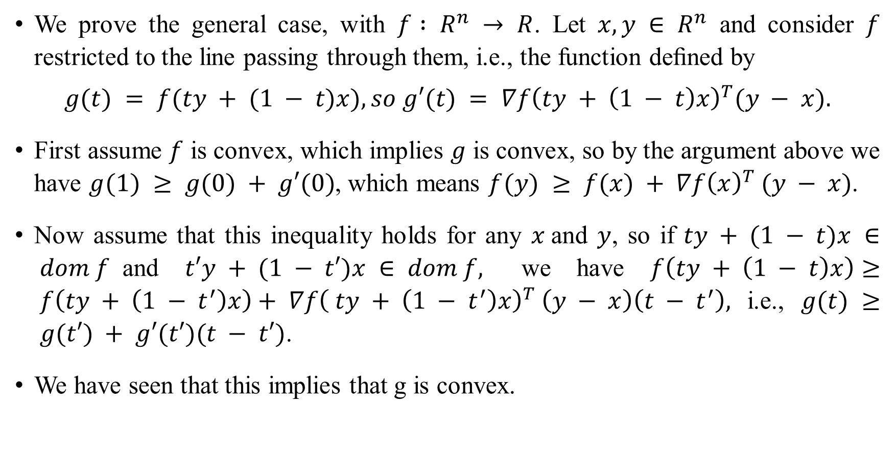
We prove the general case, with $f : R^{n} → R$. Let $x, y ∈ R^{n}$ and consider $f$ restricted to the line passing through them, i.e., the function deﬁned by
$$g(t) = f(ty + (1 − t)x), so g′(t) = ∇f{\left(ty + \left(1 − t\right)x\right)}^{T}(y − x).$$
First assume $f$ is convex, which implies $g$ is convex, so by the argument above we have $g(1) ≥ g(0) + g′(0)$, which means $f(y) ≥ f(x) + ∇f{\left(x\right)}^{T} (y − x)$.
Now assume that this inequality holds for any $x$and $y$, so if $ty + (1 − t)x ∈ dom f$and $t′y + (1 − t′)x ∈ dom f,$ we have $f\left(ty + \left(1 − t\right)x\right)≥ f\left(ty + \left(1 − t^{′}\right)x\right)+ ∇f{\left( ty + \left(1 − t^{′}\right)x\right)}^{T} \left(y − x\right)\left(t − t^{′}\right),$i.e.,$g(t) ≥ g(t′) + g′(t′)(t − t′)$.
We have seen that this implies that g is convex.

Slide 22
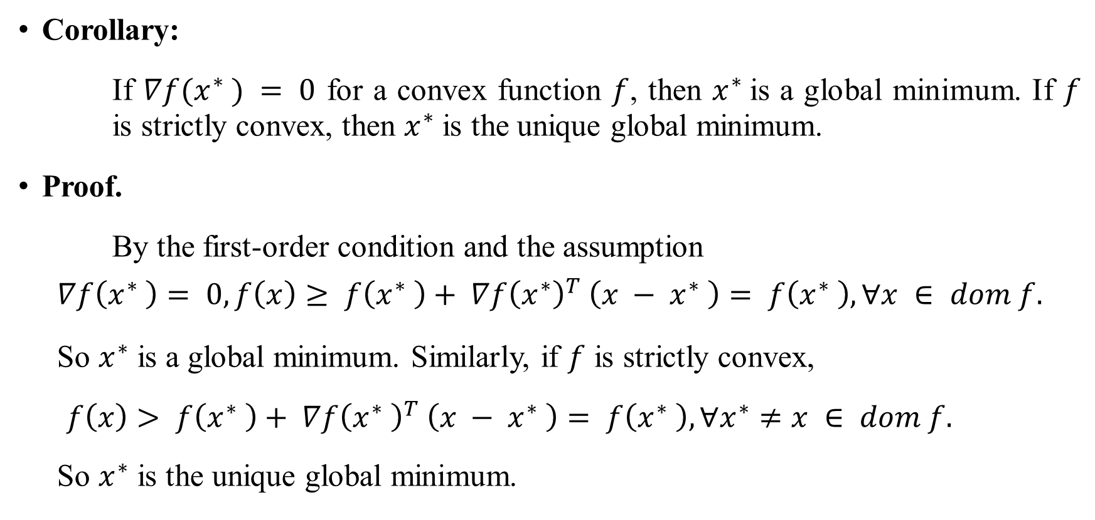
Optimality of Stationary Points
Corollary:
If $∇f(x^{∗} ) = 0$ for a convex function $f$, then $x^{∗}$is a global minimum. If $f$ is strictly convex, then $x^{∗}$ is the unique global minimum.
Proof.
By the first-order condition and the assumption
$$∇f\left(x^{∗} \right)= 0, f\left(x\right)≥ f\left(x^{∗} \right)+ ∇f{\left(x^{∗}\right)}^{T} \left(x − x^{∗} \right)= f\left(x^{∗} \right), ∀x ∈ dom f.$$
So $x^{∗}$ is a global minimum. Similarly, if $f$ is strictly convex,
$f\left(x\right)> f\left(x^{∗} \right)+ ∇f{\left(x^{∗} \right)}^{T} \left(x − x^{∗} \right)= f\left(x^{∗} \right), ∀x^{∗}≠x ∈ dom f.$
So $x^{∗}$ is the unique global minimum.

Slide 23
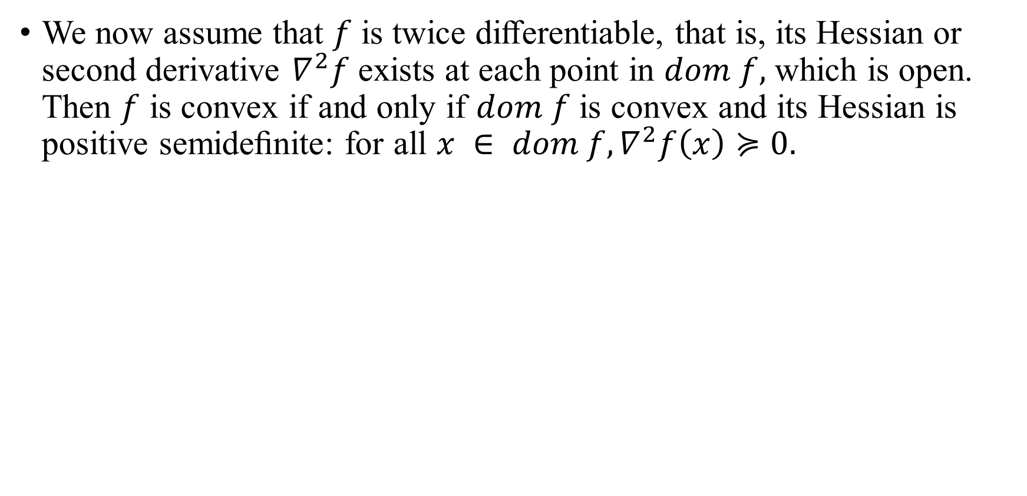
Second-order conditions
We now assume that $f$ is twice diﬀerentiable, that is, its Hessian or second derivative $∇^{2}f$ exists at each point in $dom f,$ which is open. Then $f$ is convex if and only if $dom f$ is convex and its Hessian is positive semideﬁnite: for all $x ∈ dom f,∇^{2}f\left(x\right)≽0.$

Slide 24
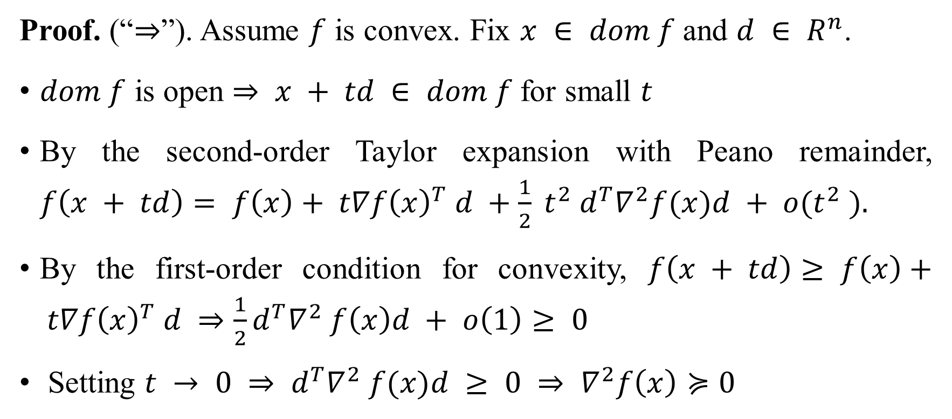
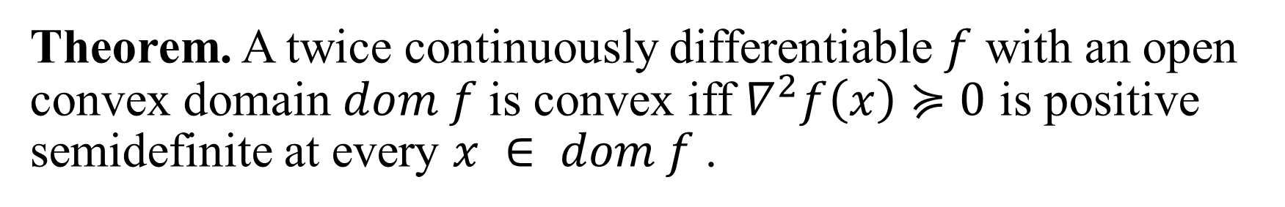
Theorem. A twice continuously differentiable $f$ with an open convex domain $dom f$is convex iff $∇^{2}f\left(x\right)≽0$ is positive semidefinite at every $x ∈ dom f$.
Proof. (“⇒”). Assume $f$ is convex. Fix $x ∈ dom f$ and $d ∈ R^{n}$.
$dom f$ is open $⇒ x + td ∈ dom f$for small $t$
By the second-order Taylor expansion with Peano remainder, $f\left(x + td\right)= f\left(x\right)+ t∇f{\left(x\right)}^{T} d +\frac{1}{2} t^{2} d^{T}∇^{2}f(x)d + o(t^{2} ).$
By the first-order condition for convexity, $f\left(x + td\right)≥ f\left(x\right)+ t∇f{\left(x\right)}^{T} d ⇒\frac{1}{2}d^{T}∇^{2} f\left(x\right)d + o\left(1\right)≥ 0$
Setting $t → 0 ⇒ d^{T}∇^{2} f(x)d ≥ 0 ⇒ ∇^{2}f\left(x\right)≽0$

Slide 25
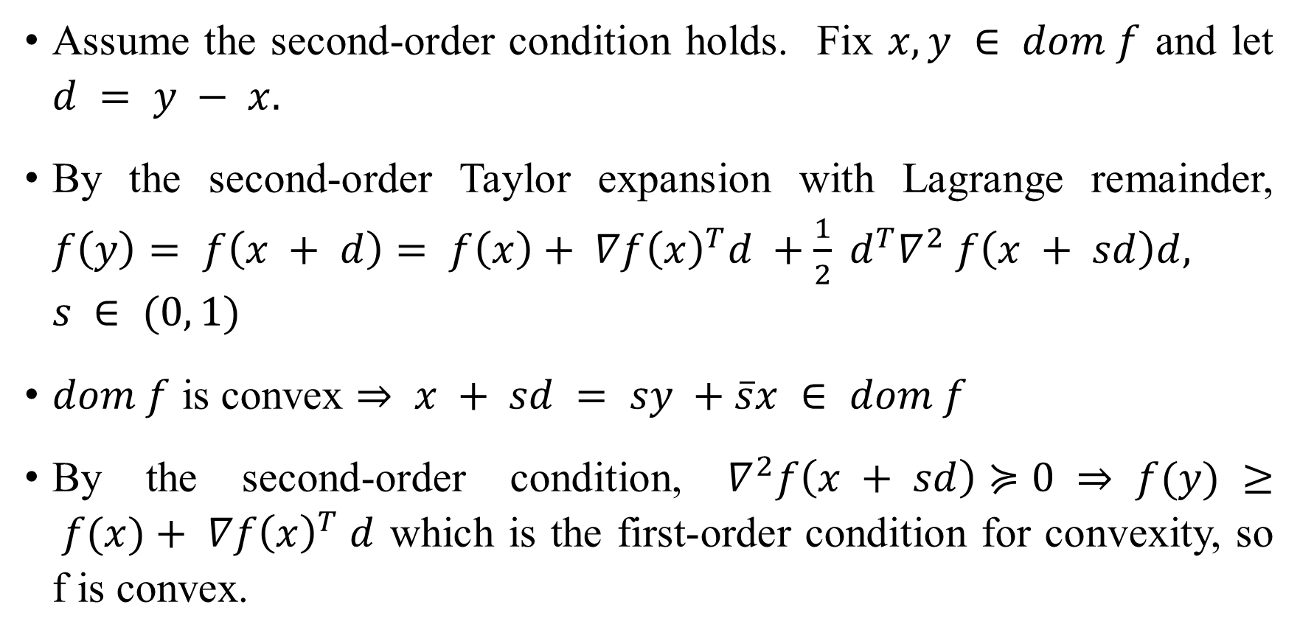
Proof (cont’d). (“⇐”).
Assume the second-order condition holds. Fix $x, y ∈ dom f$ and let $d = y − x.$
By the second-order Taylor expansion with Lagrange remainder, $f\left(y\right)= f\left(x + d\right)= f\left(x\right)+ ∇f{\left(x\right)}^{T}d +\frac{1}{2} d^{T}∇^{2} f\left(x + sd\right)d, s ∈ (0, 1)$
$dom f$ is convex $⇒ x + sd = sy +\overline{s}x ∈ dom f$
By the second-order condition, $∇^{2}f\left(x + sd\right)≽0 ⇒ f(y) ≥ f(x)+ ∇f{\left(x\right)}^{T} d$ which is the first-order condition for convexity, so f is convex.

Slide 26
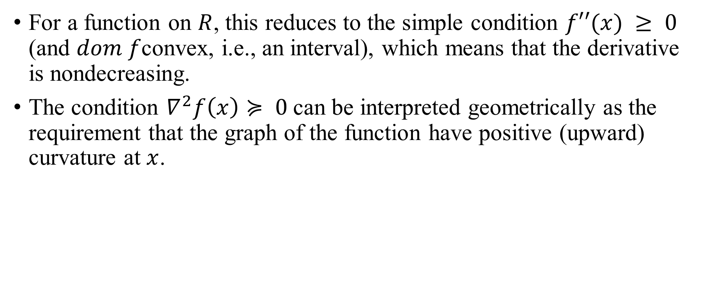

On $R$
For a function on $R$, this reduces to the simple condition $f′′(x) ≥ 0$ (and $dom f$convex, i.e., an interval), which means that the derivative is nondecreasing.
The condition $∇^{2}f\left(x\right)≽ 0$can be interpreted geometrically as the requirement that the graph of the function have positive (upward) curvature at $x$.

Slide 27
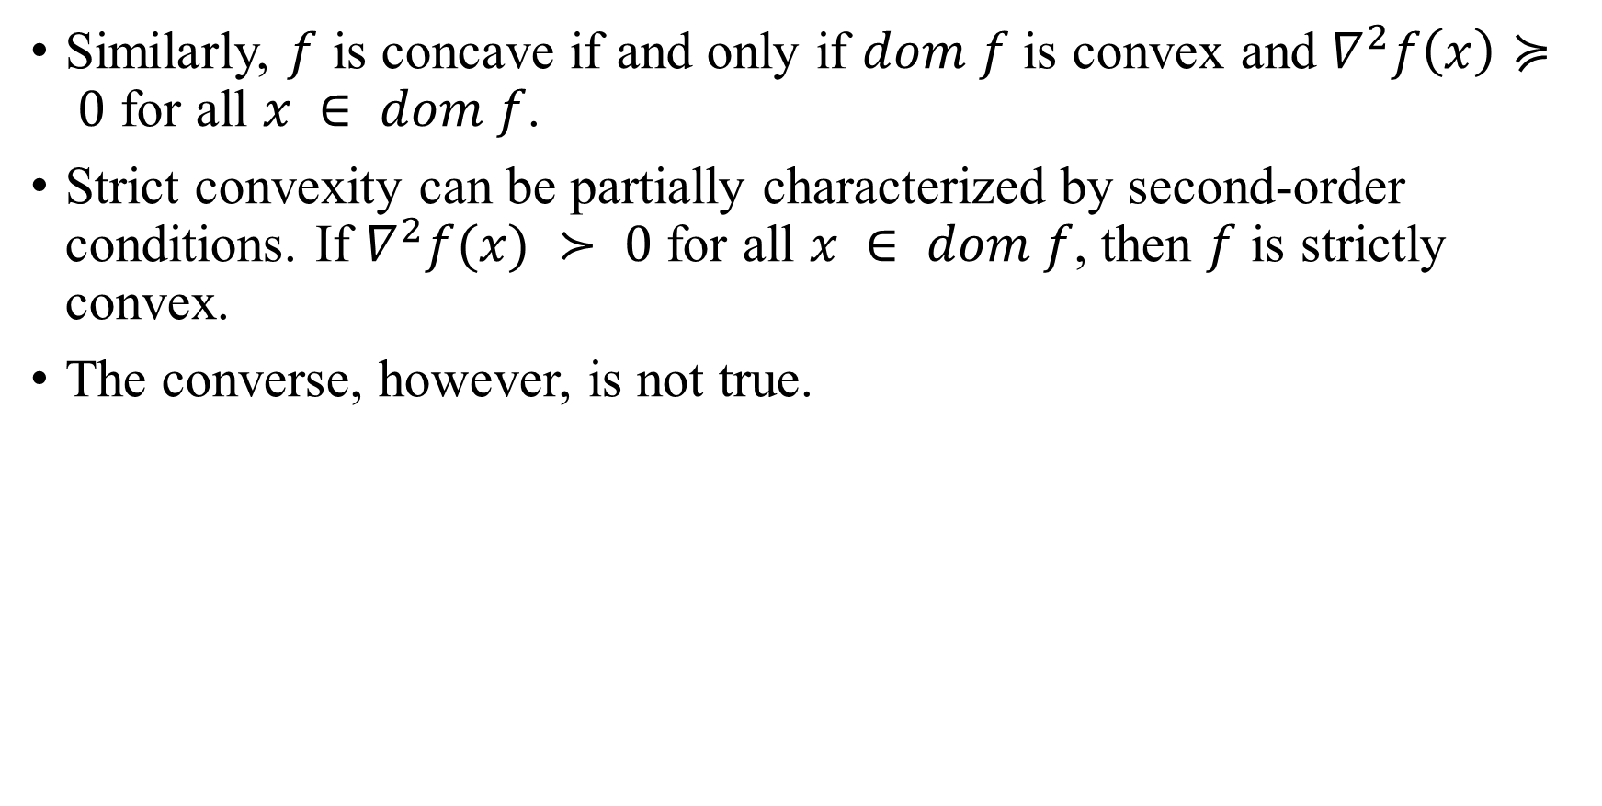
Similarly, $f$ is concave if and only if $dom f$ is convex and $∇^{2}f\left(x\right)≽ 0$ for all $x ∈ dom f$.
Strict convexity can be partially characterized by second-order conditions. If $∇^{2}f(x) ≻ 0$ for all $x ∈ dom f$, then $f$ is strictly convex.
The converse, however, is not true.

Slide 28
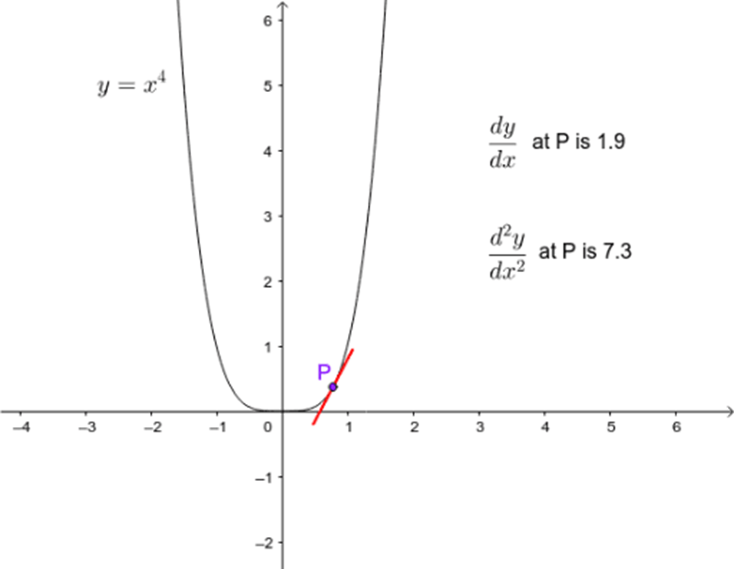
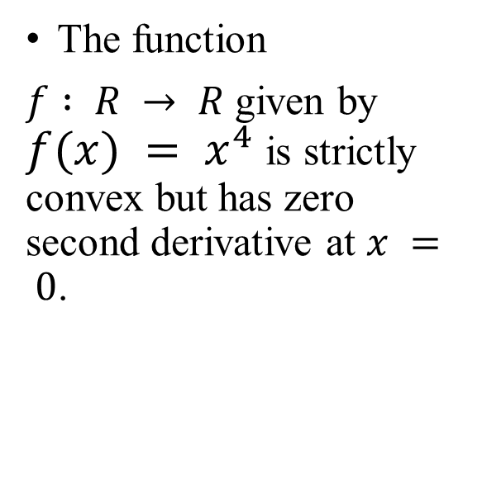
Example
The function
$f : R → R$ given by $f(x) = x^{4}$ is strictly convex but has zero second derivative at $x = 0$.

Slide 29
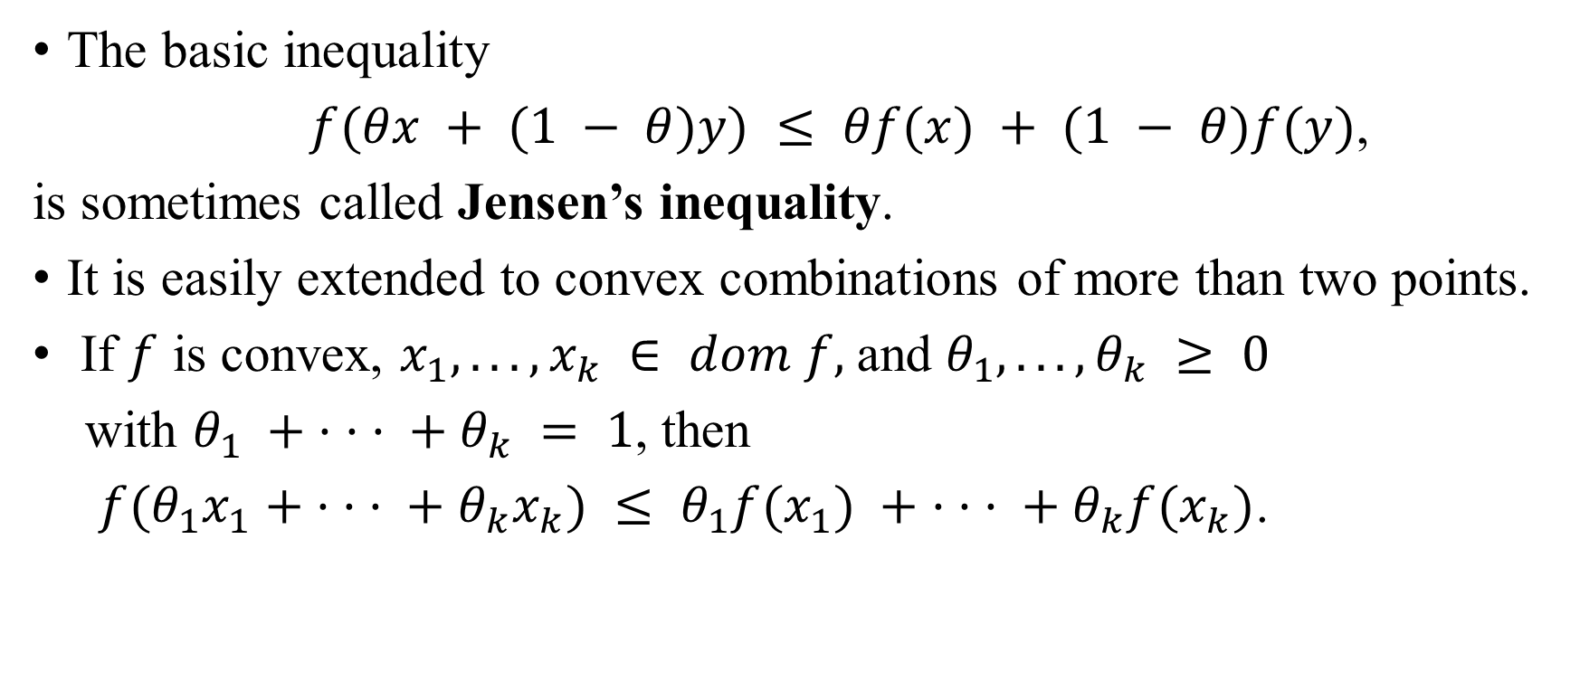
Jensen’s inequality
The basic inequality
$f(θx + (1 − θ)y) ≤ θf(x) + (1 − θ)f(y)$,
is sometimes called Jensen’s inequality.
It is easily extended to convex combinations of more than two points.
If $f$ is convex, $x_{1}, . . . , x_{k} ∈ dom f,$and $θ_{1}, . . . , θ_{k} ≥ 0$
with $θ_{1} + · · · + θ_{k} = 1$, then
$f(θ_{1}x_{1}+ · · · + θ_{k}x_{k}) ≤ θ_{1}f(x_{1}) + · · · + θ_{k}f(x_{k})$.

Slide 30
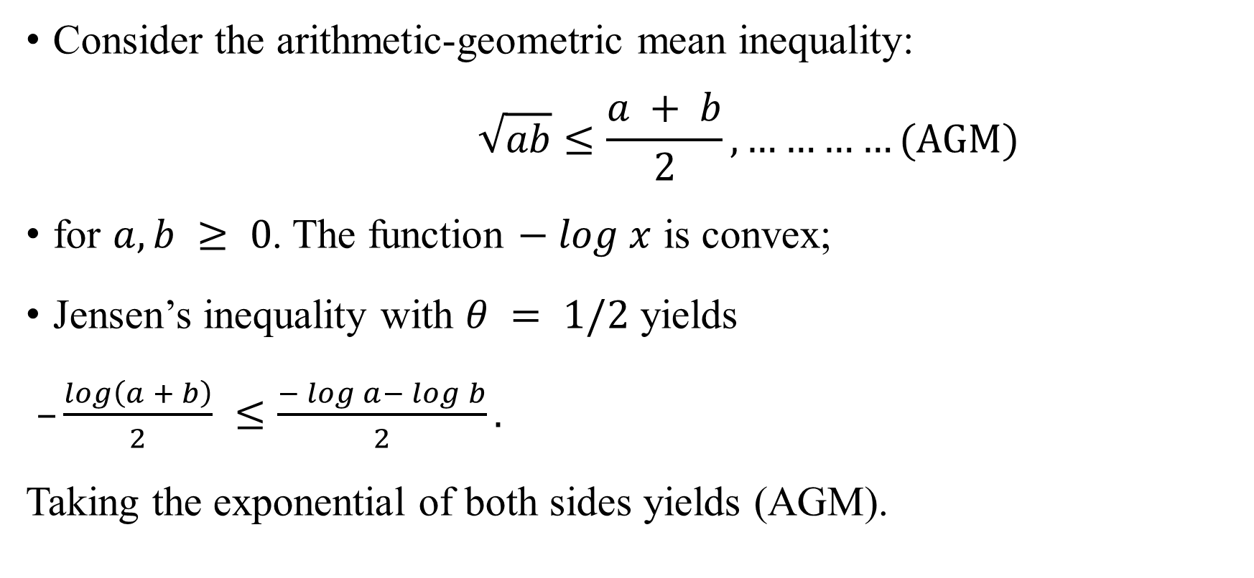
Example
Consider the arithmetic-geometric mean inequality:
$$\sqrt{ab}≤\frac{a + b}{2}, …………(AGM)$$
for $a, b ≥ 0$. The function $− log x$ is convex;
Jensen’s inequality with $θ = 1/2$ yields
$–\frac{log\left(a + b\right)}{2} ≤\frac{− log a− log b}{2}.$
Taking the exponential of both sides yields (AGM).

Slide 31
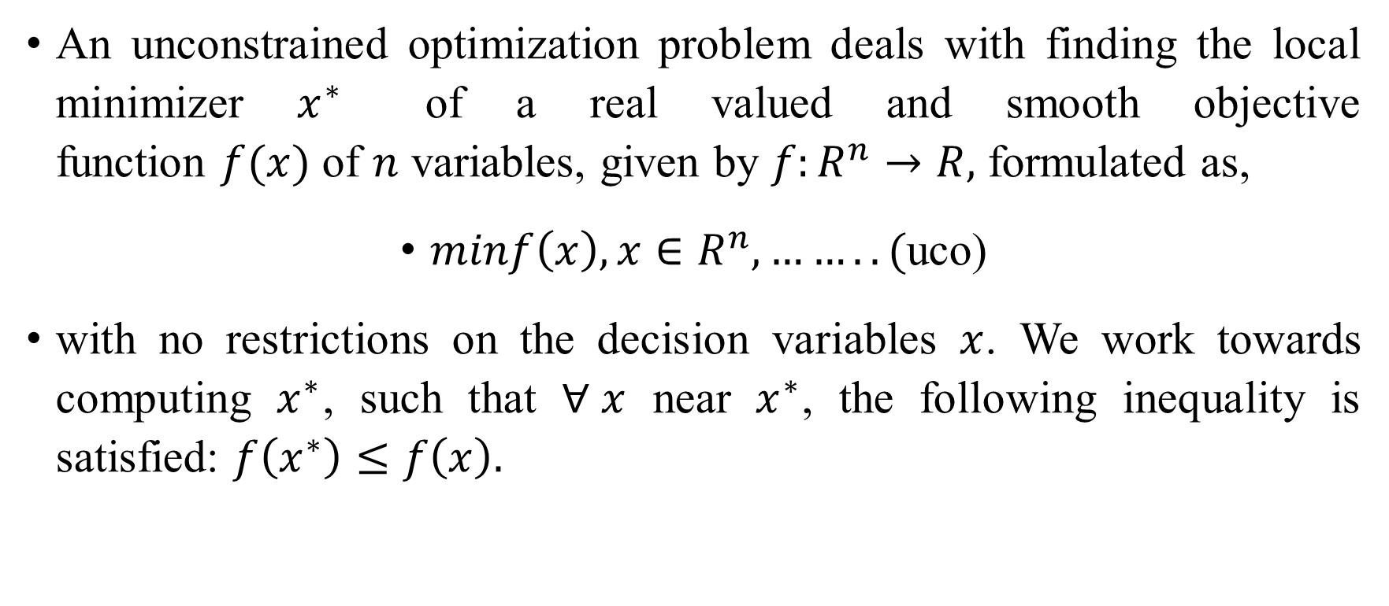
Unconstrained optimization problem
An unconstrained optimization problem deals with finding the local minimizer $x^{∗}$ of a real valued and smooth objective function $f(x)$ of $n$ variables, given by $f:R^{n}→R,$ formulated as,
$minf\left(x\right), x∈R^{n}, ……..($uco)
with no restrictions on the decision variables $x$. We work towards computing $x^{∗}$, such that $∀ x$ near $x^{∗}$, the following inequality is satisfied: $f\left(x^{∗}\right)≤f\left(x\right).$

Slide 32
Unimodal single variable function
We shall discuss here two important method for its solution
Fibonaccci search
Golden section search

Slide 33
Fibonacci search

Slide 34
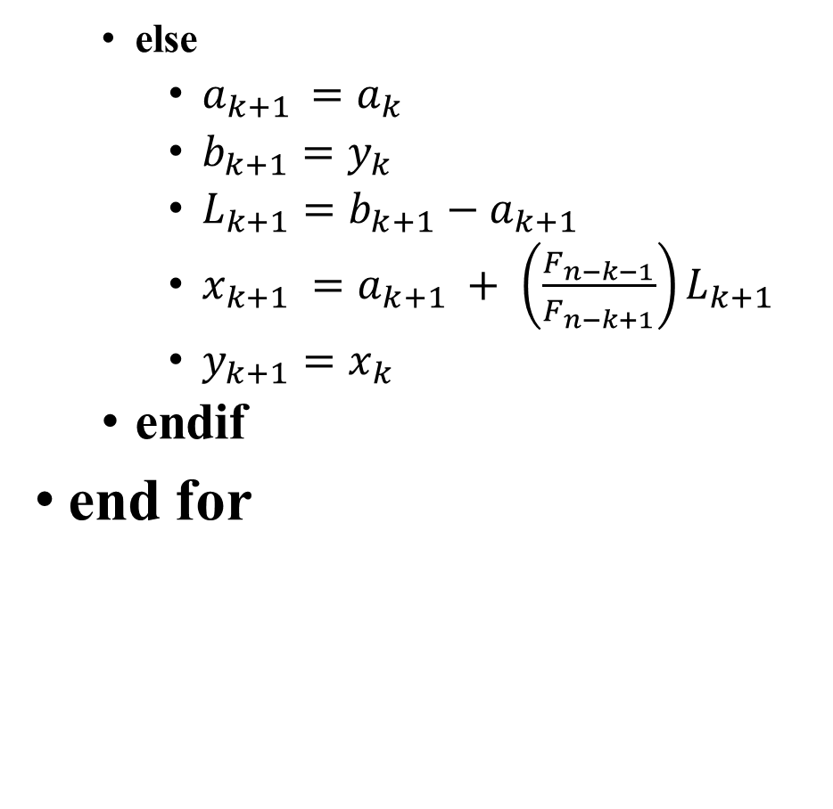
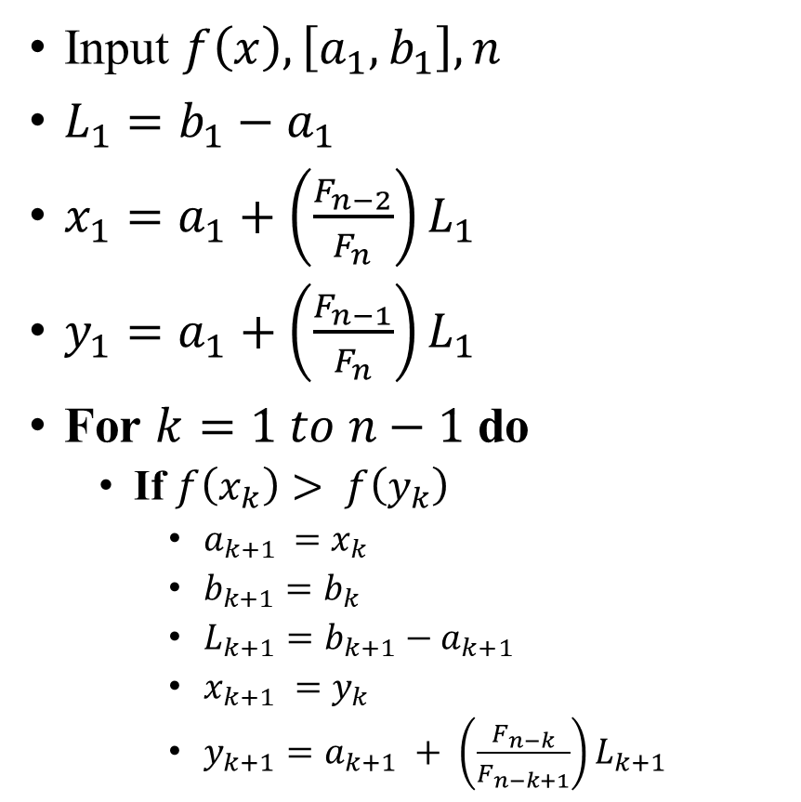
Algorithm (Fibonacci)
else
$a_{k+1 }=a_{k}$
$b_{k+1}=y_{k}$
$L_{k+1}=b_{k+1}−a_{k+1}$
$x_{k+1} =a_{k+1} + \left(\frac{F_{n−k−1}}{F_{n−k+1}}\right)L_{k+1}$
$y_{k+1}=x_{k}$
endif
end for
Input $f\left(x\right), \left[a_{1},b_{1}\right], n$
$L_{1}=b_{1}−a_{1}$
$x_{1}=a_{1}+\left(\frac{F_{n−2}}{F_{n}}\right)L_{1}$
$y_{1}=a_{1}+\left(\frac{F_{n−1}}{F_{n}}\right)L_{1}$
For $k=1 to n−1$ do
If $f\left(x_{k}\right)> f\left(y_{k}\right)$
$a_{k+1 }=x_{k}$
$b_{k+1}=b_{k}$
$L_{k+1}=b_{k+1}−a_{k+1}$
$x_{k+1} =y_{k}$
$y_{k+1}=a_{k+1} + \left(\frac{F_{n−k}}{F_{n−k+1}}\right)L_{k+1}$

Slide 35
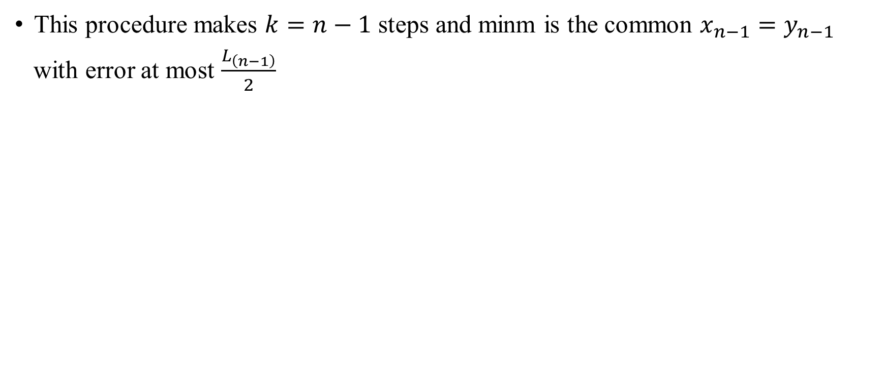
Note
This procedure makes $k=n−1$ steps and minm is the common $x_{n−1}=y_{n−1}$
with error at most $\frac{L_{\left(n−1\right)}}{2}$

Slide 36
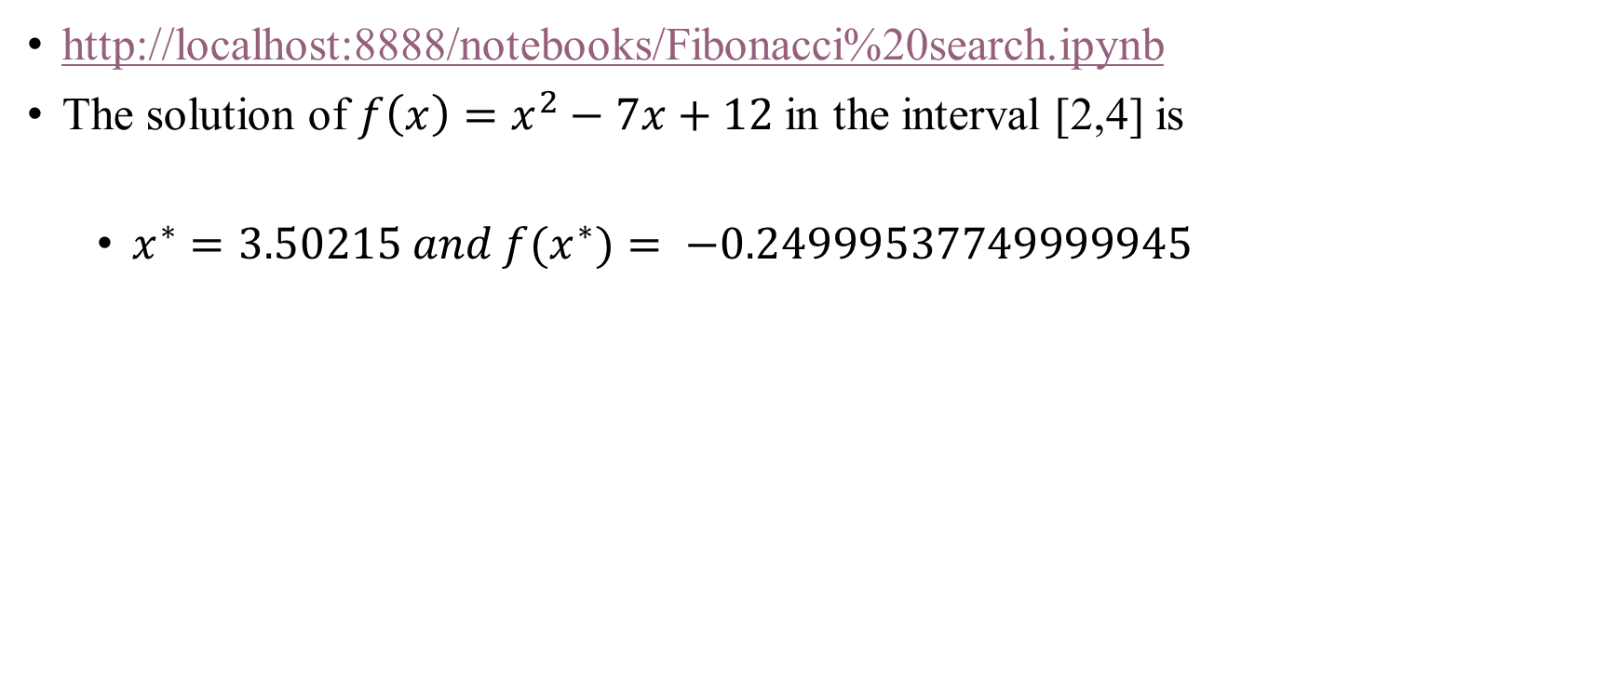
Python code
http://localhost:8888/notebooks/Fibonacci%20search.ipynb
The solution of $f\left(x\right)=x^{2}−7x+12$ in the interval [2,4] is
$x^{∗}=3.50215 and f(x^{∗})= −0.24999537749999945$

Slide 37
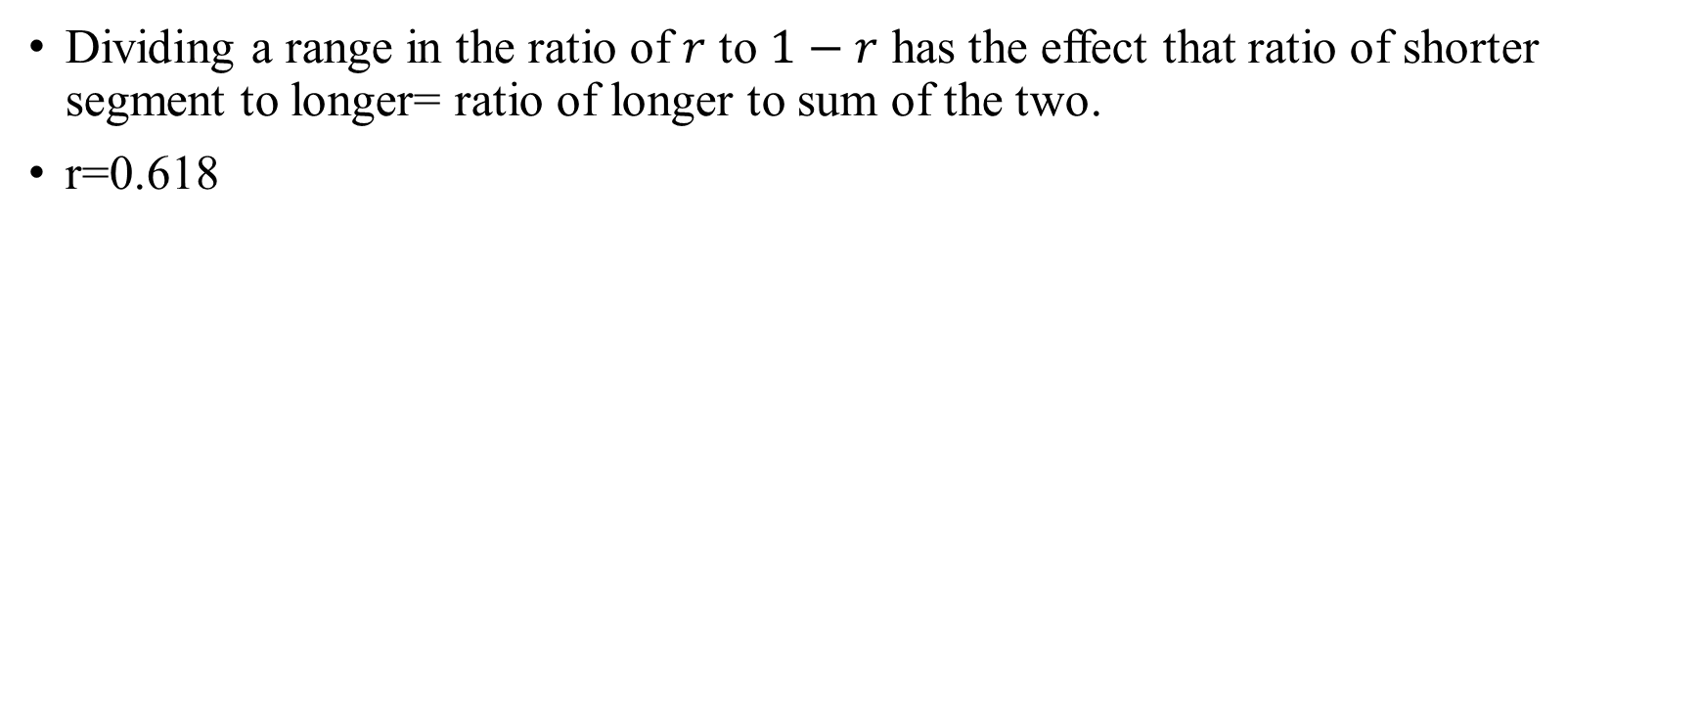
Golden section method
Dividing a range in the ratio of $r$ to $1−r$ has the effect that ratio of shorter segment to longer= ratio of longer to sum of the two.
r=0.618

Slide 38
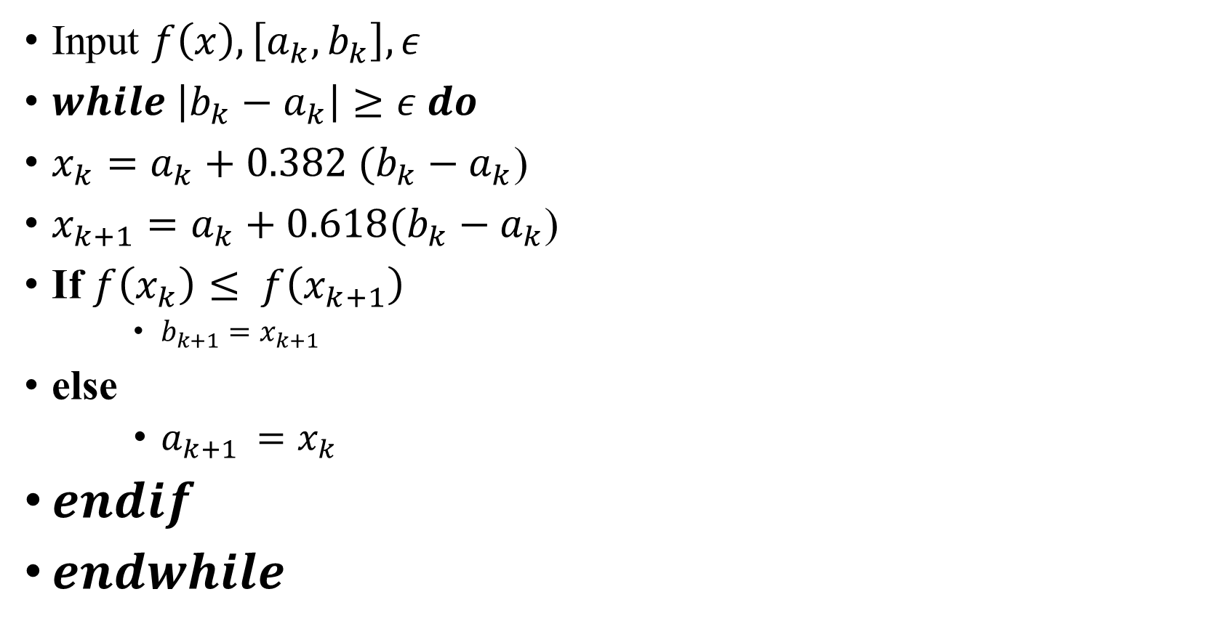
Algorithm (Golden section)
Input $f\left(x\right), \left[a_{k},b_{k}\right],ε$
$while \left|b_{k}−a_{k}\right|≥ε do$
$x_{k}=a_{k}+0.382 (b_{k}−a_{k}$)
$x_{k+1}=a_{k}+0.618{(b_{k}−a_{k}\text{) }}_{}$
If $f\left(x_{k}\right)≤ f\left(x_{k+1}\right)$
$b_{k+1}=x_{k+1}$
else
$a_{k+1 }=x_{k}$
$endif$
$endwhile$

Slide 39
Python code
http://localhost:8888/notebooks/Golden_improved.ipynb

Slide 40
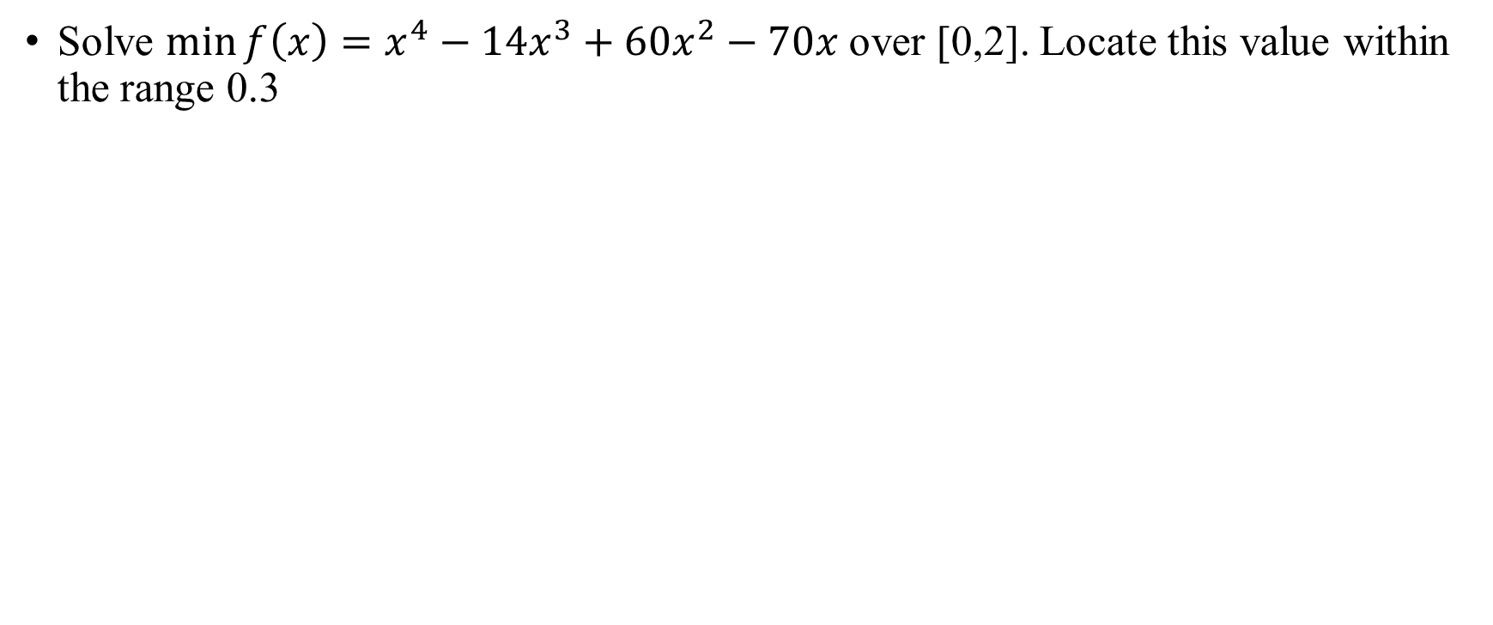
Example
Solve $\min{f\left(x\right)=x^{4}−14x^{3}+60x^{2}−70x }$over [0,2]. Locate this value within the range 0.3

Slide 42
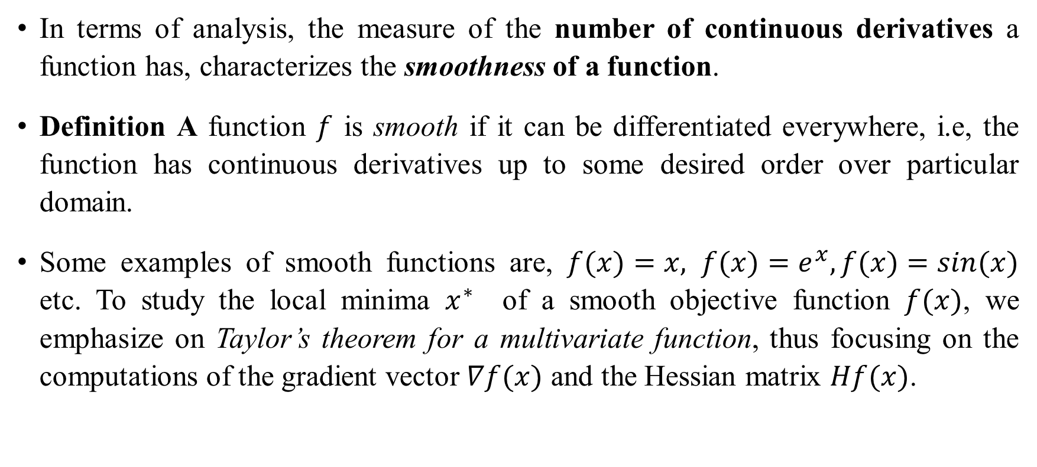
Smooth Functions
In terms of analysis, the measure of the number of continuous derivatives a function has, characterizes the smoothness of a function.
Definition A function $f$ is smooth if it can be differentiated everywhere, i.e, the function has continuous derivatives up to some desired order over particular domain.
Some examples of smooth functions are, $f(x)=x, f(x)=e^{x}, f(x)=sin(x)$ etc. To study the local minima $x^{∗}$ of a smooth objective function $f(x)$, we emphasize on Taylor’s theorem for a multivariate function, thus focusing on the computations of the gradient vector $∇f(x)$ and the Hessian matrix $Hf(x)$.

Slide 43
Necessary and Sufficient Conditions for Local Minimizer in Unconstrained Optimization

Slide 44
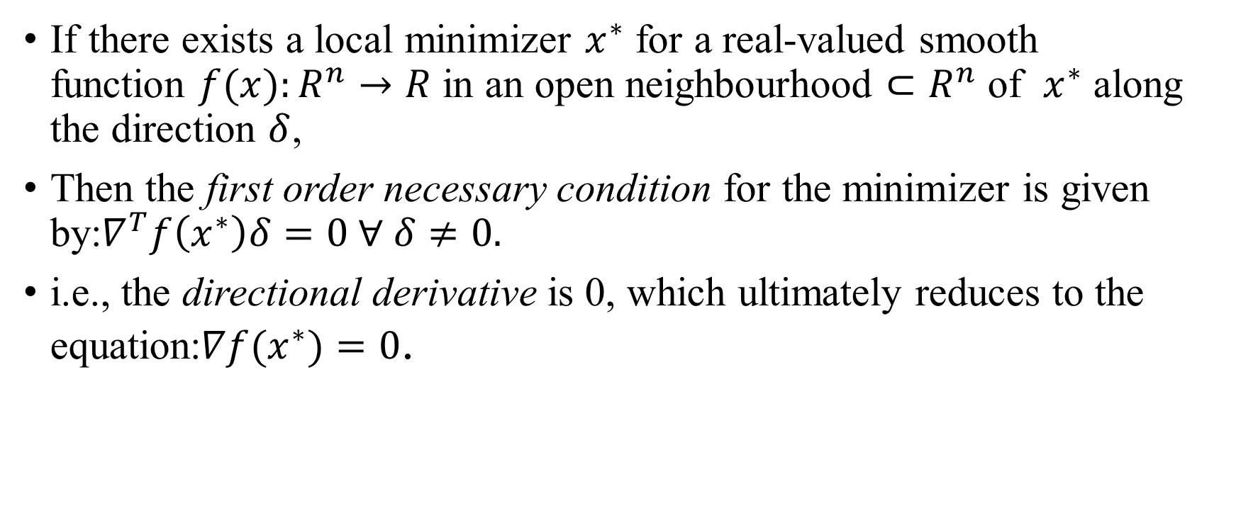
First-Order Necessary Condition
If there exists a local minimizer $x^{∗}$ for a real-valued smooth function $f(x):R^{n}→R$ in an open neighbourhood $⊂R^{n}$ of $x^{∗}$ along the direction $δ$,
Then the first order necessary condition for the minimizer is given by:$∇^{T}f\left(x^{∗}\right)δ=0 ∀ δ≠0.$
i.e., the directional derivative is 0, which ultimately reduces to the equation:$∇f(x^{∗})=0$.

Slide 45
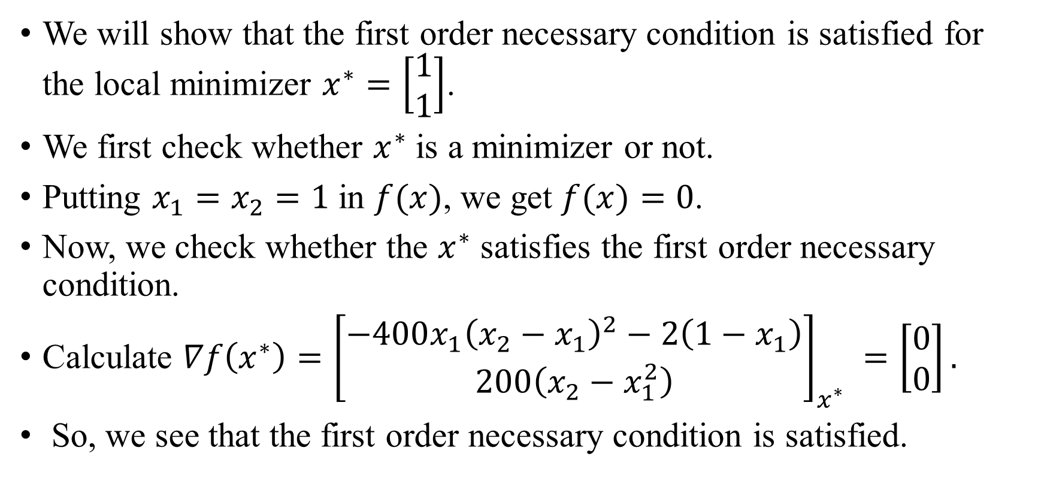
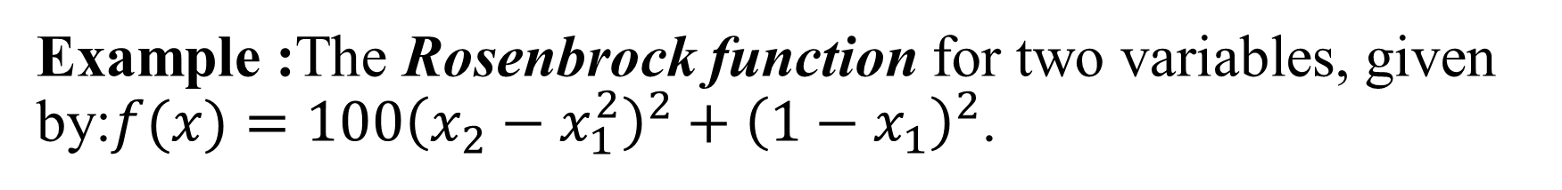
Example :The Rosenbrock function for two variables, given by:$f(x)=100{\left(x_{2}−x_{1}^{2}\right)}^{2}+{\left(1−x_{1}\right)}^{2}$.
We will show that the first order necessary condition is satisfied for the local minimizer $x^{∗}=\left[\begin{matrix}1 \\ 1\end{matrix}\right]$.
We first check whether $x^{∗}$ is a minimizer or not.
Putting $x_{1}=x_{2}=1$in $f(x)$, we get $f(x)=0$.
Now, we check whether the $x^{∗}$ satisfies the first order necessary condition.
Calculate $∇f\left(x^{∗}\right)={\left[\begin{matrix}−400x_{1}{\left(x_{2}−x_{1}\right)}^{2}−2\left(1−x_{1}\right) \\ 200\left(x_{2}−x_{1}^{2}\right)\end{matrix}\right]}_{x^{∗}} =\left[\begin{matrix}0 \\ 0\end{matrix}\right].$
So, we see that the first order necessary condition is satisfied.

Slide 46
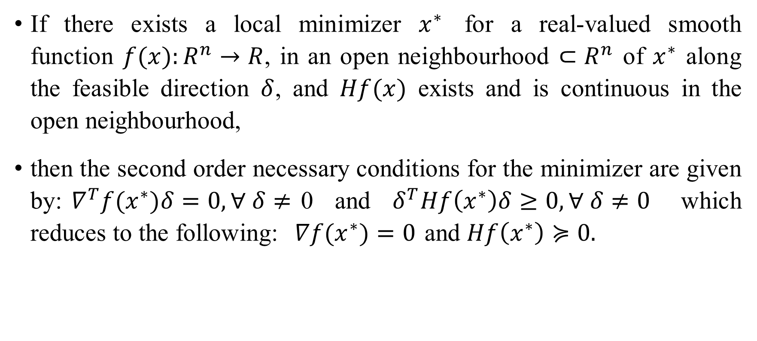
Second-Order Necessary Conditions
If there exists a local minimizer $x^{∗}$ for a real-valued smooth function $f(x):R^{n}→R$, in an open neighbourhood $⊂R^{n}$ of $x^{∗}$ along the feasible direction $δ$, and $Hf(x)$ exists and is continuous in the open neighbourhood,
then the second order necessary conditions for the minimizer are given by:$∇^{T}f(x^{∗})δ=0,∀ δ≠$0 and $δ^{T}Hf\left(x^{∗}\right)δ≥0,∀ δ≠0$ which reduces to the following:$∇f(x^{∗})=0$ and $Hf\left(x^{∗}\right)≽0.$

Slide 47
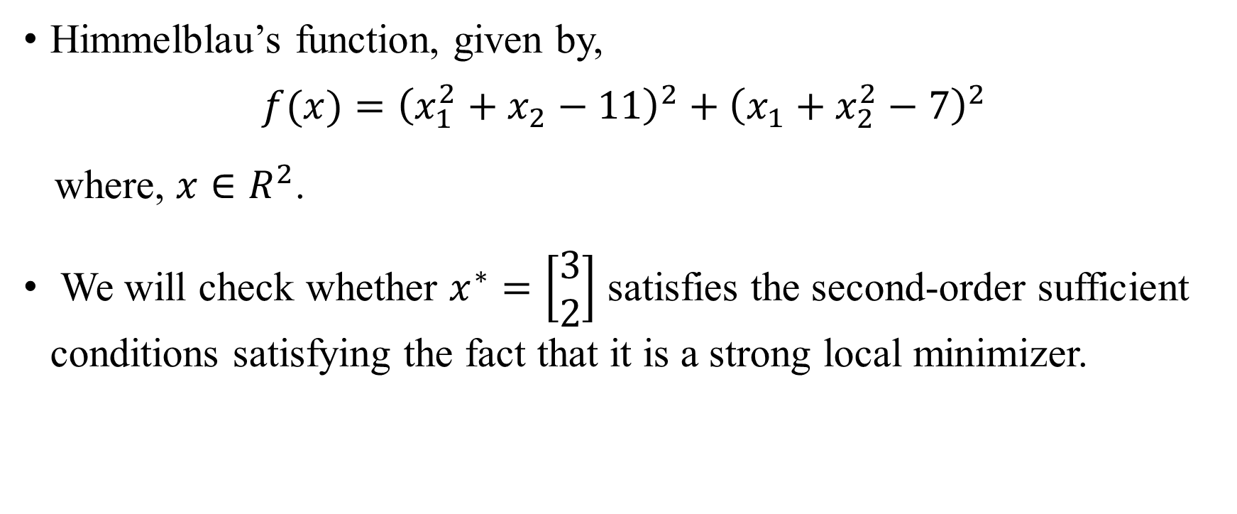
Example:
Himmelblau’s function, given by,
$$f(x)={\left(x_{1}^{2}+x_{2}−11\right)}^{2}+{\left(x_{1}+x_{2}^{2}−7\right)}^{2}$$
where, $x∈R^{2}$.
We will check whether $x^{∗}=\left[\begin{matrix}3 \\ 2\end{matrix}\right]$ satisfies the second-order sufficient conditions satisfying the fact that it is a strong local minimizer.

Slide 48
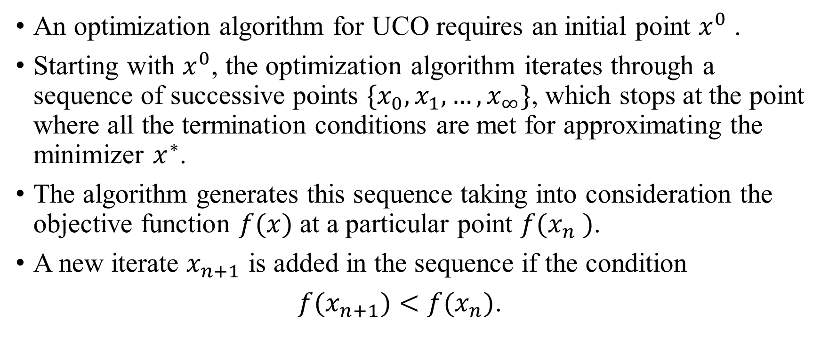
Algorithms for Solving Unconstrained Minimization problems
An optimization algorithm for UCO requires an initial point $x^{0}$ .
Starting with $x^{0}$, the optimization algorithm iterates through a sequence of successive points $\{x_{0},x_{1},…,x_{∞}\}$, which stops at the point where all the termination conditions are met for approximating the minimizer $x^{∗}$.
The algorithm generates this sequence taking into consideration the objective function $f(x)$ at a particular point $f(x_{n} )$.
A new iterate $x_{n+1}$ is added in the sequence if the condition
$f(x_{n+1})<f(x_{n})$.

Slide 49
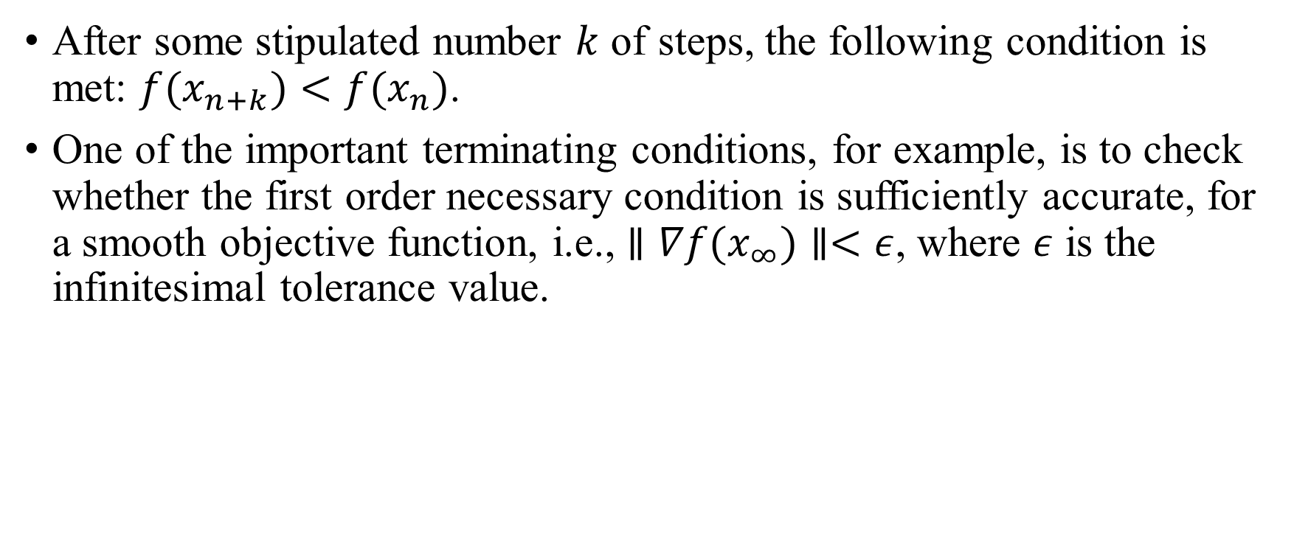
Cont…..
After some stipulated number $k$ of steps, the following condition is met: $f(x_{n+k})<f(x_{n})$.
One of the important terminating conditions, for example, is to check whether the first order necessary condition is sufficiently accurate, for a smooth objective function, i.e., $∥∇f(x_{∞})∥<ε$, where $ε$ is the infinitesimal tolerance value.

Slide 50
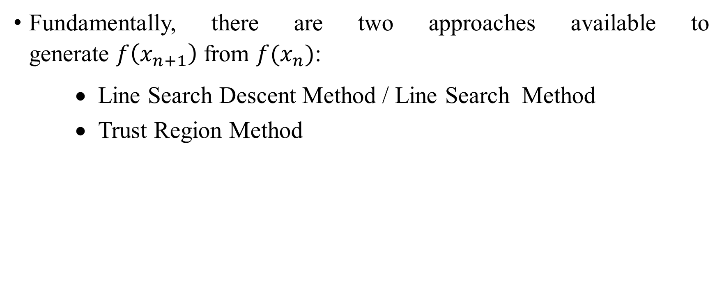
Approach
Fundamentally, there are two approaches available to generate $f\left(x_{n+1}\right)$ from $f(x_{n})$:
Line Search Descent Method / Line Search Method
Trust Region Method

Slide 51
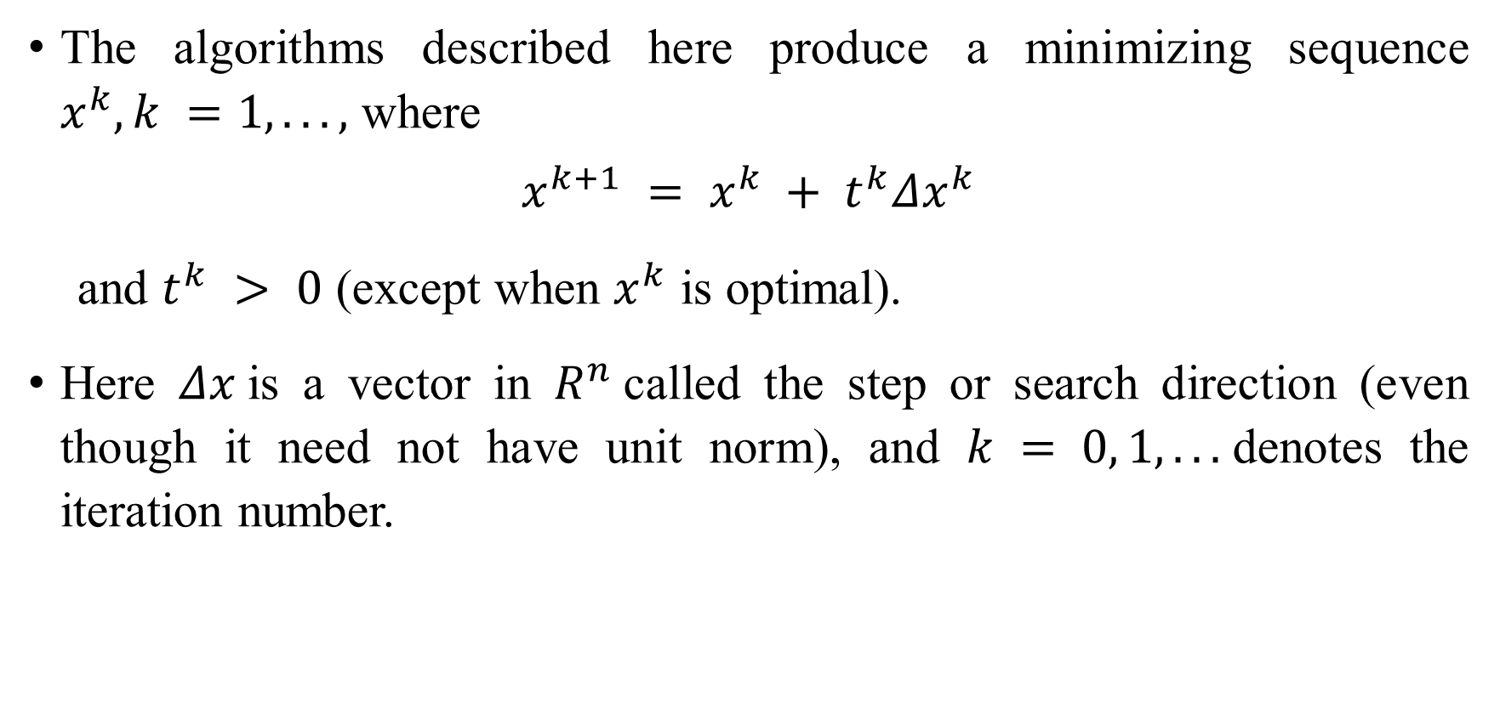
Line Search Descent Method
The algorithms described here produce a minimizing sequence $x^{k}, k =1, . . . ,$ where
$$x^{k+1} = x^{k} + t^{k}Δx^{k}$$
and $t^{k} > 0$ (except when $x^{k}$ is optimal).
Here $Δx$is a vector in $R^{n}$called the step or search direction (even though it need not have unit norm), and $k = 0, 1, . . .$denotes the iteration number.

Slide 52
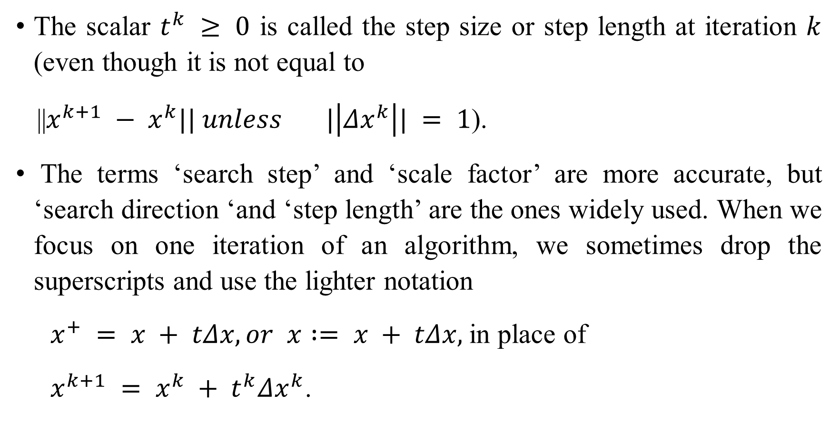
The scalar $t^{k} ≥ 0$ is called the step size or step length at iteration $k$ (even though it is not equal to
||$x^{k+1} − x^{k}|| unless |\left|Δx^{k}\right|| = 1$).
The terms ‘search step’ and ‘scale factor’ are more accurate, but ‘search direction ‘and ‘step length’ are the ones widely used. When we focus on one iteration of an algorithm, we sometimes drop the superscripts and use the lighter notation
$x^{+} = x + tΔx, or$ $x := x + tΔx,$in place of
$x^{k+1} = x^{k} + t^{k}Δx^{k}$.

Slide 53
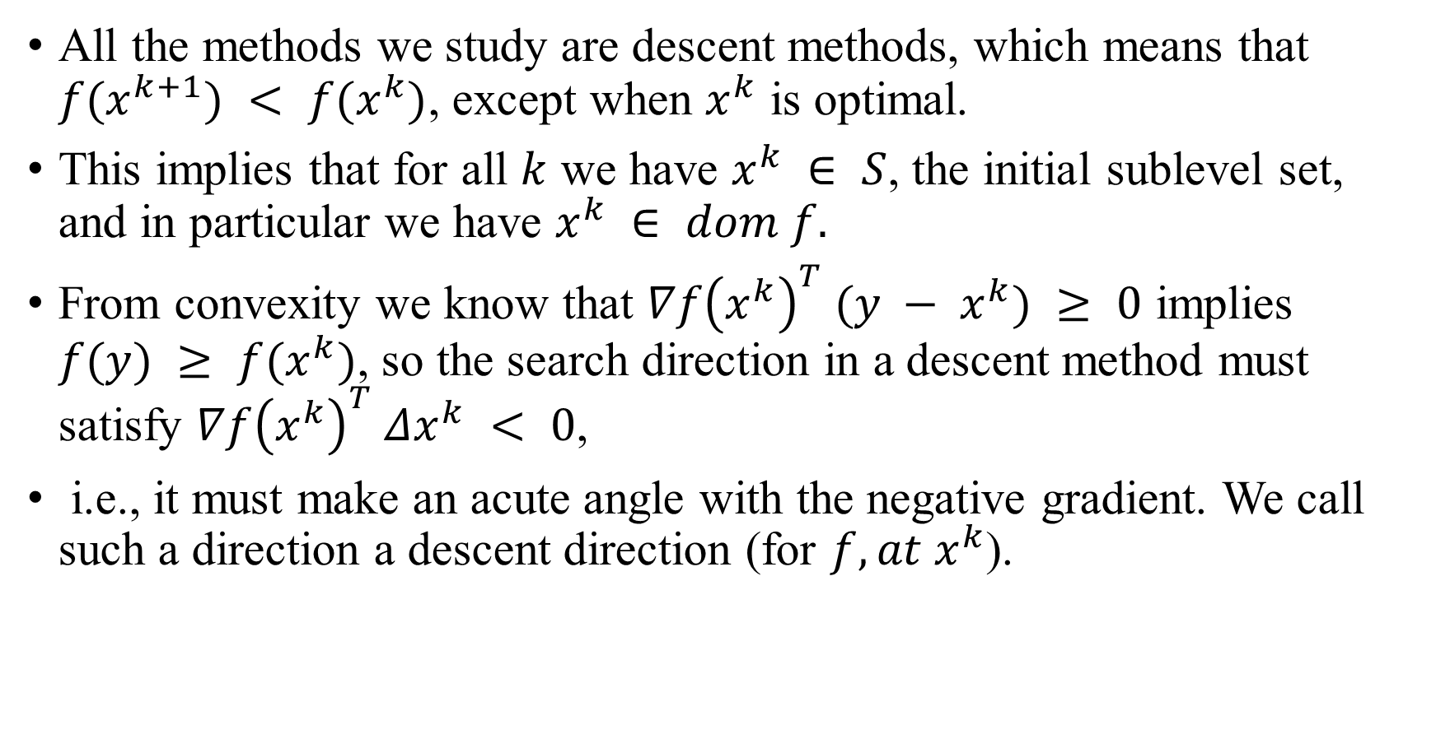
All the methods we study are descent methods, which means that $f(x^{k+1}) < f(x^{k})$, except when $x^{k}$ is optimal.
This implies that for all $k$ we have $x^{k} ∈ S$, the initial sublevel set, and in particular we have $x^{k} ∈ dom f.$
From convexity we know that $∇f{\left(x^{k}\right)}^{T} (y − x^{k}) ≥ 0$ implies $f(y) ≥ f(x^{k})$, so the search direction in a descent method must satisfy $∇f{\left(x^{k}\right)}^{T} Δx^{k} < 0$,
i.e., it must make an acute angle with the negative gradient. We call such a direction a descent direction (for $f, at x^{k}$).

Slide 54

Algorithm: General descent method.
Given a starting point $x ∈ dom f$.
repeat
1. Determine a descent direction $Δx$.
2. Line search. Choose a step size $t > 0$.
3. Update. $x := x + tΔx.$
until the stopping criterion is satisﬁed.

Slide 55

Exact line search
One line search method sometimes used in practice is exact line search, in which $t$ is chosen to minimize $f$ along the ray $\{x + tΔx | t ≥ 0\}:$
$t ={argmin}_{s≥0 } f(x + sΔx)−−−−−−−(1$)
An exact line search is used when the cost of the minimization problem with one variable, required in (1), is low compared to the cost of computing the search direction itself.
In some special cases the minimizer along the ray can be found analytically, and in others it can be computed eﬃciently.

Slide 56
Gradient descent method
Function requirements
Gradient descent algorithm does not work for all functions. There are two specific requirements such as differentiable & convex.
In the case of a univariate function, it is simply the first derivative at a selected point. In the case of a multivariate function, it is a vector of derivatives in each main direction (along variable axes). Because we are interested only in a slope along one axis and we don’t care about others these derivatives are called partial derivatives.

Slide 57

Gradient Descent Method
A natural choice for the search direction is the negative gradient
$Δx = −∇f(x)$.
The resulting algorithm is called the gradient algorithm or gradient descent method.

Slide 58

Algorithm: Gradient descent method
Given a starting point $x ∈ dom f$.
repeat
1. $Δx := −∇f(x)$.
2. Line search. Choose step size $t$ via exact line search
3. Update. $x := x + tΔx$.
until the stopping criterion is satisﬁed.

Slide 59

Stopping criterion
The stopping criterion is usually of the form
${\left|\left|∇f\left(x\right)\right|\right|}_{2} ≤ η$,
where $η$ is small and positive.
In most implementations, this condition is checked after step 1, rather than after the update.

Slide 60


Slide 61

Some contour lines of the function $f(x) = \frac{1}{2}(x_{1}^{2} + 10x_{2}^{2})$.
The sublevel set is defined as $S = \{x ∈ dom f | f(x) ≤ f(x^{0})\}$.
The condition number of the sublevel sets, which are ellipsoids, is exactly 10.
The ﬁgure shows the iterates of the gradient method with exact line search, started at $x_{0} = (10, 1)$.
The condition number indicates whether the problem is ill- or well-conditioned.
More specifically, the condition number gives a bound for the relative error in the solution when a small perturbation is applied to the input data.

Slide 62
Some Gradient Descent methods
gradient descent method,
conjugate gradient decent method,
Newton’s method,
quasi-newton method,
Levenberg-Marquardt method.

Slide 63

Gradient Descent (GD) Algorithm
Initialize $w$ as $w^{(0)}$
For iteration $t=0,1,2,…$(or until convergence)
Calculate the gradient $g^{(t)}=∇_{w}\left[L(w^{(t)})\right]$using the current iterates $w^{(t)}$
Set the learning rate $η_{t}$
Move in the opposite direction of gradient
$w^{(t+1)}= w^{(t)}−η_{t}g^{(t)}$
= $w^{(t)}−η_{t}∇_{w}\left[L(w^{(t)})\right]$

Slide 64

Some Obvious questions?
When do we stop in GD algorithm?
Possible Stopping Criteria: iterate until $\left\|g\right\|≤ε$ for some $ε>0$
How small should $ε$ be?
Can I used this approach to solve maximization problems?
For max. problems we can use gradient ascent$w^{(t+1)}= w^{(t)}+η_{t}g^{(t)}$
Will move in the direction of the gradient
Is it a Iterative method?
Iterative since it requires several steps/iterations to find the optimal solution.

Slide 65




An Experiment
$$f\left(x\right)=x^{2}$$
Step size: 0$.8$
$$x^{(0)}=−4$$

Slide 66



Experiment
Step size: $.8$
$$x^{(0)}=−4$$
$$x^{(1)}=−4− .8⋅2⋅\left(−4\right)$$
$$=2.4$$

Slide 67




Gradient Descent
$$f\left(x\right)=x^{2}$$
Step size: $.8$
$$x^{(0)}=−4$$
$$x^{(1)}=2.4$$
$$x^{(2)}=2.4− .8⋅2⋅2.4$$
$$x^{(1)}=0.4$$

Slide 68






Gradient Descent
$$f\left(x\right)=x^{2}$$
Step size: $0.8$
$$x^{(0)}=−4$$
$$x^{(1)}=2.4$$
$x^{(2)}=−$1.44
$$x^{(3)}=0.864$$
$$x^{(4)}=−0.5184$$
$$x^{(5)}=0.31104$$
$$x^{(30)}=−8.84296e−07$$

Slide 69

Expt cont….
If step size is 0.9

Slide 70

Gradient Descent
Step size: .2

Slide 71

Gradient Descent
Does Step size matters?

Slide 72


Does Learning rate matters?

Slide 73

Line Search
Instead of picking a fixed step size that may or may not actually result in a decrease in the function value, we can consider minimizing the function along the direction specified by the gradient to guarantee that the next iteration decreases the function value
In other words choose, $w^{t+1}∈\arg{\min_{γ≥ 0}{L(w^{(t)}−η_{t}∇_{w}\left[L(w^{(t)})\right])}}$
This is called exact line search
This optimization problem can be expensive to solve exactly ☹
However, if $L$ is convex, this is a univariate convex optimization problem

Slide 74

Backtracking Line Search
Instead of exact line search, could simply use a strategy that finds some step size that decreases the function value (one must exist)
Backtracking line search: start with a large step size, $γ$, and keep shrinking it until$L(w^{\left(t\right)}−η_{t}∇_{w}\left[L\left(w^{\left(t\right)}\right)\right]<L(w^{\left(t\right)})$
This always guarantees a decrease, but it may not decrease as much as exact line search
Still, this is typically much faster in practice as it only requires a few function evaluations

Slide 75

Backtracking Line Search
To implement backtracking line search, choose two parameters $α∈\left(0,0.5\right), β∈(0,1)$
Set $η=1$
While $L\left(w^{t} −η∇L\left(w^{t}\right)\right)>L\left(w^{t}\right)− α⋅η⋅{\left\|∇L\left(w^{t}\right)\right\|}^{2}$
$η=βη$
Set $w^{t+1}=w^{t} −η∇L\left(w^{t}\right)$

Slide 76


Backtracking Line Search
$$α=.2, β=.99$$

Slide 77

Backtracking Line Search
$$α=.1, β=.3$$

Slide 78
Gradient Descent: Convex Functions
For convex functions, local optima are always global optima (this follows from the definition of convexity)
If gradient descent converges to a critical point, then the result is a global minimizer
Not all convex functions are differentiable, can we still apply gradient descent?

Slide 79

Dealing with Non-differentiable Functions
In many ML problems, the objective function will be non-differentiable
Some examples are: Linear regression with absolute loss, Huber loss, $ε$-insensitive loss; even $ℓ_{1}$ norm regularizer are non-diff
However, for convex non-diff fn, one can define sub-gradients at point(s) of non-differentiabilty.
Basically, any function in which there are points with kink (turn or bend that should be straight) is non-diff
At such points, the function is non-differentiable and thus gradients not defined
Reason: Can’t define a unique tangent at such points

Slide 80






Sub-gradients
For convex non-diff fn, can define sub-gradients at point(s) of non-differentiabilty
For a convex, non-diff function $f(x)$, sub-gradient at$x_{∗}$is any vector $g$ s.t. $∀x$
differentiable
here
Equation of unique tangent at $x_{1}$
$$f\left(x_{1}\right)+g^{⊤}(x−x_{1})$$
One extreme tangent at $x_{2}$
$$f\left(x_{2}\right)+g_{1}^{⊤}(x−x_{2})$$
non-differentiable
here
Region containing all sub-gradients
The other extreme tangent at $x_{2}$
$$f\left(x_{2}\right)+g_{2}^{⊤}(x−x_{2})$$
$$x_{1}$$
$$x_{2}$$
$$f\left(x\right)≥f\left(x_{∗}\right)+ g^{⊤}(x−x_{∗})$$

Slide 81





Sub-Gradient For Absolute Value function
$$|t|$$
It is a convex and non-diiferentiable
function at t=0.
$$|t|$$
$$0$$
$$t$$
$∂\left|t\right|= \left\{\begin{aligned}1 if t>0 \\ −1 if t<0 \\ \left[−1,+1\right] if t=0\end{aligned}\right.$

Slide 82


Sub-Gradient Descent
Suppose we have a non-differentiable function $L(w)$.
Then we may take a sub-gradient $g^{(t)}∈∂L(w^{(t)})$ at $w^{t}$ instead of the gradient.
Sub-gradient descent is almost identical to GD except we use sub-gradients.
Initialize $w$ as $w^{(0)}$
For iteration $t=0,1,2,…$(or until convergence)
Calculate the sub-gradient $g^{(t)}∈∂L(w^{(t)})$
Set the learning rate $η_{t}$
Move in the opposite direction of subgradient
Sub-Gradient Descent
$$w^{(t+1)}= w^{(t)}−η_{t}g^{(t)}$$

Slide 83
Conjugate Gradient method

Slide 84

Mutual Conjugacy
Suppose we want to find the minimizer of an objective function, having the quadratic form $\min_{x∈R^{n}}f(x)=\frac{1}{2}x^{T}Ax−b^{T}x$
For a given symmetric positive definite matrix $A$, two vectors $v,w≠0∈R^{n}$ are defined to be mutually conjugate if $v^{T}A w=0$

Slide 85
Linear Conjugate Gradient Method
This is an iterative method to solve large linear systems where the coefficient matrices are positive definite. This can be treated as a replacement of the Gaussian elimination method in numerical analysis.

Slide 86

Conjugate Direction Algorithm linear conjugate gradient algorithm

Slide 87

Example &its code
$f\left(x_{1},x_{2}\right)=\frac{x_{1}^{2}}{2}+x_{1}x_{2}+x_{2}^{2}−2x_{2}$
$A=[\frac{1}{2} \frac{1}{2};\frac{1}{2} 1], x=[x_{1}; x_{2}] and b=[0;2]$
Choose $x^{0}=[−2.3; 2.2]$ & $ε={10}^{−5}.$

Slide 88
def f(x): # Define the objective function
return x[0]**2/2 + x[0]*x[1] + x[1]**2 - 2*x[1]
# we define the matrix A and the vector b in Python
A = np.array(([1/2, 1/2], [1/2, 1]), dtype=float)
b = np.array([0., 2.])
# A is actually a symmetric positive definite matrix?
eigs = np.linalg.eigvals(A)
print("The eigenvalues of A:", eigs)
if (np.all(eigs>0)):
print("A is positive definite")
elif (np.all(eigs>=0)):
print("A is positive semi-definite")
else:
print("A is negative definite")

Slide 89
# Symmetric check
if (A.T==A).all()==True: print("A is symmetric")
#main Algo
def linear_CG(x, A, b, epsilon):
res = A.dot(x) - b # Initialize the residual
delta = -res # Initialize the descent direction
while True:
if np.linalg.norm(res) <= epsilon:
return x, f(x) # Return the minimizer x* and the function value f(x*)
D = A.dot(delta)
beta = -(res.dot(delta))/(delta.dot(D)) # Line (11) in the algorithm
x = x + beta*delta # Generate the new iterate
res = A.dot(x) - b # generate the new residual
chi = res.dot(D)/(delta.dot(D)) # Line (14) in the algorithm
delta = chi*delta - res # Generate the new descent direction
#we pass the parameters
linear_CG(np.array([2.3, -2.2]), A, b, 10**-5)

Slide 91
Constrained Optimization and KKT conditions

Slide 93

A general constrained minimization problem may be written as (CNLP): $min f(x)$
Subject to
$g_{j}(x) ≤ 0, j = 1, . . . , p,$
$h_{i}(x) = 0, i = 1, . . . , m,$
where $g_{j}, h_{i} : R^{n} → R$ are inequality and equality constraint functions, respectively.

Slide 94

We can write the constrained optimization concisely as
minimize $f(x)$
subject to
$g\left(x\right)≤ 0,$
$h(x) = 0$.
The feasible set is $Ω := \{x ∈ R^{n} : g(x) ≤ 0, h(x) = 0\}$.

Slide 95

Definition
A point $x^{∗}$ satisfying the constraint $h(x^{∗}) = 0$is said to be a
regular point of the constraint
if the gradient vectors $∇h_{1} (x^{∗}),∇h_{2}(x^{∗})….,∇h_{n}(x^{∗})$ are linearly independent.

Slide 96
Solution methods
Three situations possible:
Equality constraints
Inequality constraints
Mixed Constraints

Slide 97
Equality constraints

Slide 98

FIRST-ORDER NECESSARY CONDITIONS (FONC)
Lemma. Let $x^{∗}$ be a regular point of the constraints $h(x)=0$ and a local extremum point (a minimum or maximum) of $f$ subject to these constraints. Then $∇h \left(x^{∗}\right)y=0$ $∀ y∈R^{n}$ must also satisfy $∇f(x^{∗})y =0.$

Slide 99

FONC(Lagrange Condition)
The Lagrange condition, of the equality-constrained minimization problem is as follows:
Theorem. Let $x^{∗}$ be a local extremum point of $f$ subject to the constraints $h(x)=0$. Assume further that $x^{∗}$ is a regular point of these constraints. Then there is a $λ∈R^{n}$ such that $∇f\left(x^{∗}\right)+λ^{T}h\left(x^{∗}\right)=0.$
Remark. The conditions above are necessary but not sufﬁcient to determine $x^{∗}$ to be a local minimizer—a point satisfying these conditions could be a local maximizer or neither

Slide 100

We introduce the Lagrange function $𝓛\left(x, λ\right)= f\left(x\right)+λ^{T}h\left(x\right).$
Then the Lagrange condition becomes
$$∇x𝓛\left(x^{∗}, λ^{∗}\right)=0 and ∇_{λ}𝓛\left(x^{∗}, λ^{∗}\right)=0$$
Note that this is a system of $n + m$ equations for $[x; λ] ∈ R^{n+m}$ (which has $n + m$ unknowns).

Slide 101

Example
maximize $x_{1}x_{2}x_{3}$
subject to
$2(x_{1}x_{2} + x_{2}x_{3} + x_{3}x_{1}) = A$.
(convert to min and adjust objective and constraints).
Solving this system yields $x_{1} = x_{2} = x_{3} =\sqrt{\frac{A}{6}}$ , $λ =\frac{1}{2}\sqrt{\frac{A}{6}}$ .

Slide 102

Second-Order Necessary Conditions
Theorem (SONC): Let $x^{∗}$ be a local minimizer of $f : R^{n} → R$over $Ω = \{x :h(x) = 0 ∈ R^{n}\}$ with $m ≤ n$, where $f, h ∈ C^{2}$. Suppose $x^{∗}$ is regular, then $∃ λ^{∗} = [λ_{1}^{∗}; . . . ; λ_{m}^{∗}] ∈ R^{m}$ such that (1). $∇f\left(x^{∗}\right)+λ^{T}h\left(x^{∗}\right)=0$;
(2) $∇^{2}f(x^{∗}) + \sum_{i}^{m}{λ_{i}^{∗}∇^{2}h_{i}(x^{∗})}$ is Hessian.

Slide 103

Second-order sufﬁcient condition (SOSC)
Theorem (SOSC). Suppose $x^{∗} ∈ Ω = \{x : h(x) = 0\}$ is regular. If ∃ $λ^{∗} =[λ_{1}^{∗}; . . . ; λ_{m}^{∗}] ∈ R^{m}$such that
(1) $∇f\left(x^{∗}\right)+λ^{T}h\left(x^{∗}\right)=0$;
(2) $∇^{2}f(x^{∗}) + \sum_{i}^{m}{λ_{i}^{∗}∇^{2}h_{i}(x^{∗})}$ is Hessian.
Then $x^{∗}$ is a strict local minimizer of $f$ over $Ω$.

Slide 104

Mixed Constraints
The constrained optimization problems with both equality and inequality constraints is
minimize $f(x)$
subject to
$$g\left(x\right)≤ 0$$
$$h\left(x\right)= 0$$
The feasible set is $Ω = \{x ∈ R^{n} : g(x) ≤ 0, h(x) = 0\}.$
Note that $g\left(x\right)= \left[g_{1}\left(x\right); . . . ; g_{p}\left(x\right)\right]∈ R^{p} and$
$$h\left(x\right)= \left[h_{1}\left(x\right); . . . ; h_{m}\left(x\right)\right]∈ R^{m}.$$

Slide 105

Definitions
We call the inequality constraint $g_{j}$ $active$ at $x ∈ Ω$if $g_{j}(x) = 0$ and inactive if $g_{j}(x) < 0.$
Denote $J(x)$ the index set of active constraints at $x$: $J(x) = \{j : g_{j}(x) = 0\}.$ Also denote $J_{c}(x) = \{1, . . . , p\} \backslash J(x)$ as its complement.
We call $x$ a regular point in $Ω$ if $∇h_{i}(x), ∇g_{j}(x), 1 ≤ i ≤ m, j ∈ J(x)$ are linearly independent (total of $m + |J(x)|$ vectors in $R^{n}$).

Slide 106

First order necessary condition (FONC)
Theorem [Karush-Kahn-Tucker (KKT)]. Suppose $f, g, h ∈ C^{1}, x^{∗}$ is a regular point and local minimizer of $f$, then $∃ λ^{∗} ∈ R^{m}, µ^{∗} ∈ R^{p}$ such that
$∇f{\left(x^{∗}\right)}^{⊤} + {λ^{∗}}^{⊤}∇h\left(x^{∗}\right)+ {µ^{∗}}^{⊤}∇g(x^{∗}) = 0^{⊤}$
$h(x^{∗}) = 0,$
$g(x^{∗}) ≤ 0$,
$µ^{∗} ≥ 0$,
${µ^{∗}}^{⊤}g(x^{∗}) = 0$.

Slide 107

Remarks.
Deﬁne Lagrange function: $𝓛\left(x, λ, µ\right)= f\left(x\right)+ λ^{⊤}h\left(x\right)+ µ^{⊤}g(x)$. Then the ﬁrst KKT condition is just $∇_{x}𝓛(x^{∗}, λ^{∗}, µ^{∗}) = 0$.
The second and third KKT conditions are just the constraints.
$λ$ is the Lagrange multiplier and $µ$ is the KKT multiplier.
Since $µ∗ ≥ 0$ and $g(x^{∗}) ≤ 0,$ the last KKT condition implies
$µ_{j}∗g_{j}(x^{∗}) =0$ for all $j = 1, . . . , p.$
Namely $g_{j}(x^{∗}) < 0$ implies $µ_{j}^{∗} = 0.$ Hence $µ_{j}^{∗} = 0, ∀ j≠ J(x^{∗}).$

Slide 108

Example.
Consider the problem
minimize $f(x_{1}, x_{2}) = x_{1}^{2} + x_{2}^{2} + x_{1}x_{2} − 3x_{1}$
subject to $x_{1}, x_{2} ≥ 0.$
The Lagrange function is $𝓛\left(x, µ\right)=x_{1}^{2} + x_{2}^{2} + x_{1}x_{2} − 3x_{1} − x_{1}µ_{1} − x_{2}µ_{2}$
The KKT condition is $2x_{1} + x_{2} − 3 − µ_{1} = 0$, $x_{1} + 2x_{2} − µ_{2} = 0$, $x_{1}, x_{2}, µ_{1}, µ_{2} ≥ 0$
$µ_{1}x_{1} + µ_{2}x_{2} = 0$
Solving these yields $x_{1}^{∗} = µ_{2}^{∗} =\frac{3}{2}, x_{2}^{∗} = µ_{1}^{∗} = 0.$

Slide 109
Primal-Dual method for solving constrained optimization problems
Why do we prefer Dual Problem over Primal Problem in convex optimization?

Slide 110
The dual problem provides a lower bound for the primal problem.
The dual problem is always concave. If the primal problem is hard to optimise (not convex, high-dimensional) it's easier to find a lower bound via the dual and use it as an approximation for the primal problem. i.e. the dual problem is a concave maximization problem, which is a convex optimization problem.
The dual problem has as many variables as constraints are there in the primal. So, you can reduce the dimensionality.
However, the primal-dual method simultaneously solve the primal and dual problems.

Slide 111

Primal-Dual method for solving constrained optimization problems
Consider a general optimization problem (called as primal problem)
$\min_{x}{f(x)}$
subject to ----------(1)
$$g_{j}\left(x\right)≤ 0, j = 1, . . . , p,$$
$h_{i}(x) = 0, i = 1, . . . , m,$
We deﬁne its Lagrangian as $𝓛\left(x, λ, µ\right)= f\left(x\right)+ λ^{⊤}h\left(x\right)+ µ^{⊤}g(x)$.

Slide 112

Lemma 1 At each feasible $x, f\left(x\right)=\sup_{μ,≥0,λ} 𝓛(x, u, v),$ and the supremum is taken iﬀ $μ ≥ 0$satisfying $μ_{j}g_{j}(x) = 0, j = 1, · · · , p.$
Proof: At each feasible $x$, we have $g_{j} (x) ≤ 0$ and $h(x) = 0,$ thus $𝓛\left(x, λ, µ\right)= f\left(x\right)+ λ^{⊤}h\left(x\right)+ µ^{⊤}g\left(x\right)≤f\left(x\right).$ The last inequality becomes equality iﬀ $μ_{j}g_{j}(x) = 0, j = 1, · · · , p.$
Proposition 1 The optimal value of the primal problem, named as $f^{⋆}$, satisﬁes: $f^{⋆}=\inf_{x}{\sup_{μ≥0,λ}} 𝓛(x,μ,λ).$

Slide 113

Lagrange dual function:
Given a Lagrangian, we deﬁne its Lagrange dual function as $G\left(μ,λ\right)=\inf_{x}{𝓛}(x,μ,λ).$
Lagrange dual problem
Given primal problem (1), we deﬁne its Lagrange dual problem as
$\max_{μ,λ}{G\left(μ,λ\right) }$subject to $μ ≥ 0.$-------(2)

Slide 114

Proposition 2 The optimal value of the dual problem, named as $G^{⋆}$, satisﬁes:
$$G^{⋆} =\sup_{μ ≥0,λ}\inf_{x}{𝓛(x,μ,λ)}.$$
Proposition.3 The dual problem is a convex optimization problem.

Slide 115

Weak and strong duality
The Lagrangian dual problem yields a lower bound for the primal problem. It always holds true that $f^{⋆} ≥ G^{⋆},$ called as weak duality.
In some problems, we have $f^{⋆} = G^{⋆}$, which is called strong duality.

Slide 116

Since the strong and weak duality, the point $x^{∗}$ and ($μ^{∗} , λ^{∗}$) are respectively primal and dual optimal solutions if and only if $x^{∗}$ is a feasible point of primal problem and ($μ^{∗} , λ^{∗}$)) is a feasible point of dual problem. In other words, ($x^{∗},μ^{∗},λ^{∗}$) is the solution of
$∇𝓛(x,μ,λ)= 0^{⊤}$
$h(x) = 0,$
$g(x) ≤ 0$,
$μ ≥ 0$,
$μ^{⊤}g(x) = 0$.
Moreover, these conditions are exactly the KKT conditions.

Slide 117

Let us demonstrate on a LPP
We consider the LPP in standard form:
$min⁡c^{T} x$,
subject to $Ax =b, x ≥ 0,$ (lpp1)
where $c$ and $x$ are vectors in $R^{n}$, $b$ is a vector in $R^{m}$, and $A$ is an
$m × n$ matrix.

Slide 118

The dual problem for (lpp1) is
$max⁡b^{T} λ, subject to A^{T} λ + s= c, s ≥ 0,$(lpp2)
where $λ$ is a vector in $R^{m}$ and $s$ is a vector in $R^{n}$.
The primal–dual solutions of (lpp1), (lpp2) are characterized by the Karush–Kuhn–Tucker conditions.

Slide 119

which we restate here as follows:
1. $A^{T} λ + s= c, … (lpp3a)$
2. $Ax = b,$ ……….. (lpp3b)
3. $x_{i}s_{i}= 0, i= 1, 2, . . . , n,$ (lpp3c)
4. $\left(x, s\right)≥ 0…………….$ (lpp3d)

Slide 120

Primal–dual methods ﬁnd solutions $(x^{∗}, λ^{∗}, s^{∗})$ of this system by applying variants of Newton’s method to the three equalities in (lpp3) and modifying the search directions and step lengths so that the inequalities $(x, s) ≥ 0$ are satisﬁed strictly at every iteration.
The equations (lpp3a), (lpp3b), (lpp3c) are only mildly nonlinear and so are not difﬁcult to solve by themselves.
However, the problem becomes much more difﬁcult when we add the nonnegativity requirement (lppd). The nonnegativity condition is the source of all the complications in the design and analysis of interior-point methods.
Derivation of primal–dual interior-point method is omitted.

Slide 121
Any Query??

